Slide 1


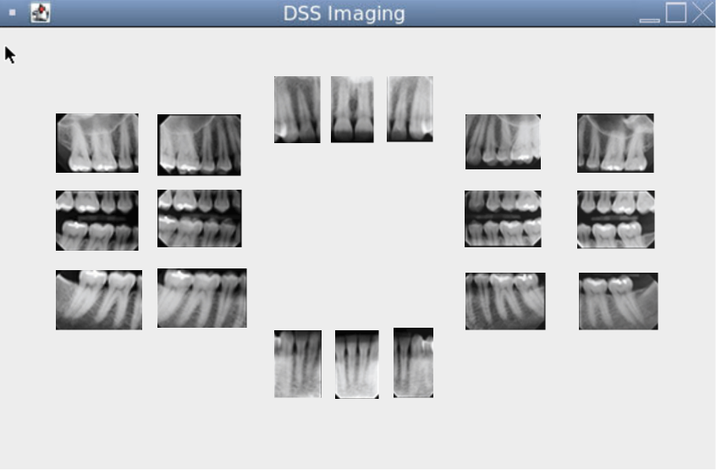

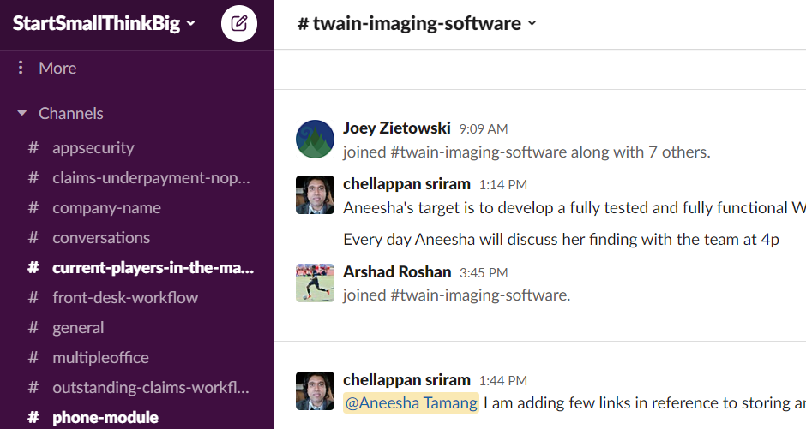

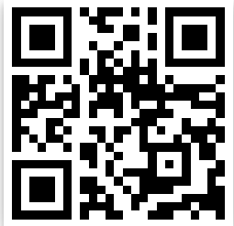
Smiles of Hyattsville and North Bethesda
Dental Software Services
Aneesha Tamang
College Park Scholars – Science & Global Change Program
Computer Science
atamang@umd.edu
College Park Scholars Academic Showcase, May 6, 2022
Introduction
Smiles of Hyattsville and North Bethesda are two local dental offices owned by Dr. Deepa Suryanarayan, DMD. I worked with her husband, Mr. Sriram Chellappan (a software engineer), to create a business communication platform specifically geared towards dental workers. This software application is called Dental Software Services (DSS).
Activities
I was tasked with writing an application that retrieved intraoral scans stored by their file paths in a database and displayed them in particular positions on the screen based on certain metadata.
The Smiles of Hyattsville/ North Bethesda logo.
Issues Confronting Site
When I first began communication with Smiles, they were looking for software developers for their new business communication platform. Their vision for the platform was something very similar to Slack, with video and audio calling and a channel-based chat feature. However, they wished to add features specific to the needs of a dental office, such as a dental imaging, appointment scheduling, and text chats between dentists and pharmacies and/or insurance companies.
In dentistry, every tooth in a person’s mouth is assigned a standardized number. Smiles stored the file paths of patients’ X-rays in a SQL database alongside the corresponding assigned numbers of the teeth present in the scans. This is the metadata that my application used to determine the position of the images.
Impact
In the summer that I worked with Smiles, I was able to contribute to a business platform that facilitated communication between dentists, other dental staff (assistants, receptionists, etc.), and patients. My supervisor plans to sell DSS to other dental offices, so I also contributed to the development of a marketable tech product.
Working this internship over the summer taught me a lot, in terms of hard and soft skills. I learned MySQL, Java Swing, and GUI design. I also learned to communicate and work in a team in a professional setting.
A screengrab of the DSS team’s Slack, where we communicated extensively and received inspiration for the design of our own platform! The workspace was called “StartSmallThinkBig” in honor of our software development philosophy.
Site Information:
Name of Site: Smiles of Hyattsville/ North Bethesda
Address: 6525 Belcrest Rd Suite 212, Hyattsville, MD 20782
Your supervisor: Sriram Chellappan
The site mission: To develop a business communication platform specifically for the use of dental offices.
Future Work
I will not be working with Smiles again this summer, but my work has set the baseline for future developers that they take on to improve the imaging component of DSS. Some aspirations that my supervisor had were to add a scroll-over magnifying feature and an ML-based cavity detection scanner. The app that I developed, while rudimentary, will give them a good jumping off point to add these features rather than starting completely from scratch.
Acknowledgments:
I would like to thank my supervisor, Mr. Sriram Chellappan, Dr. Holtz, and Dr. Merck for making this service learning opportunity possible!

