Slide 1
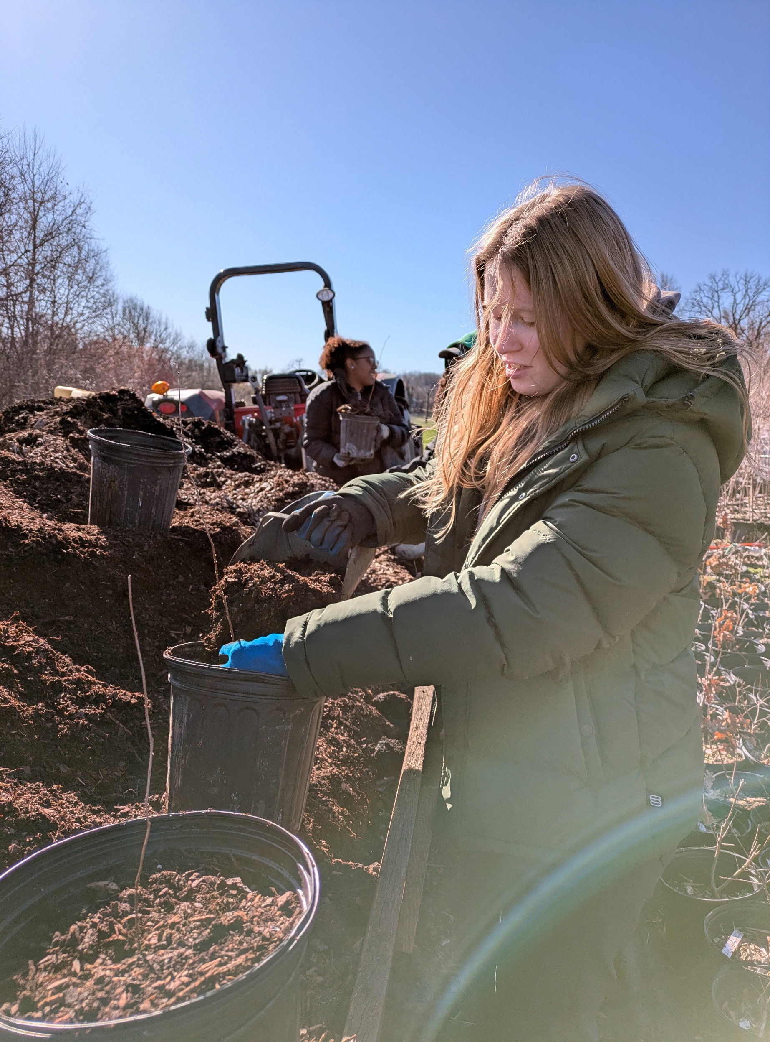
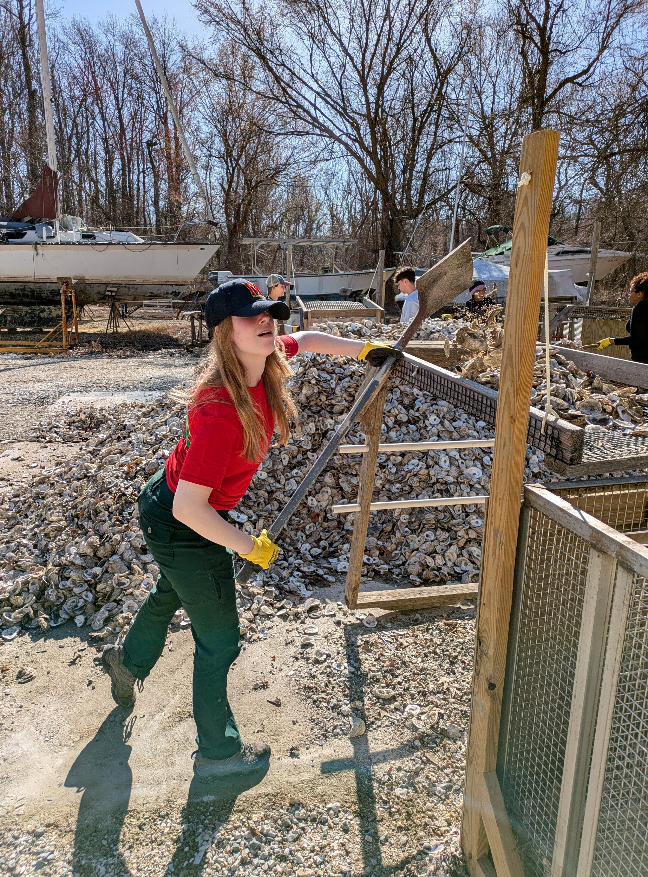
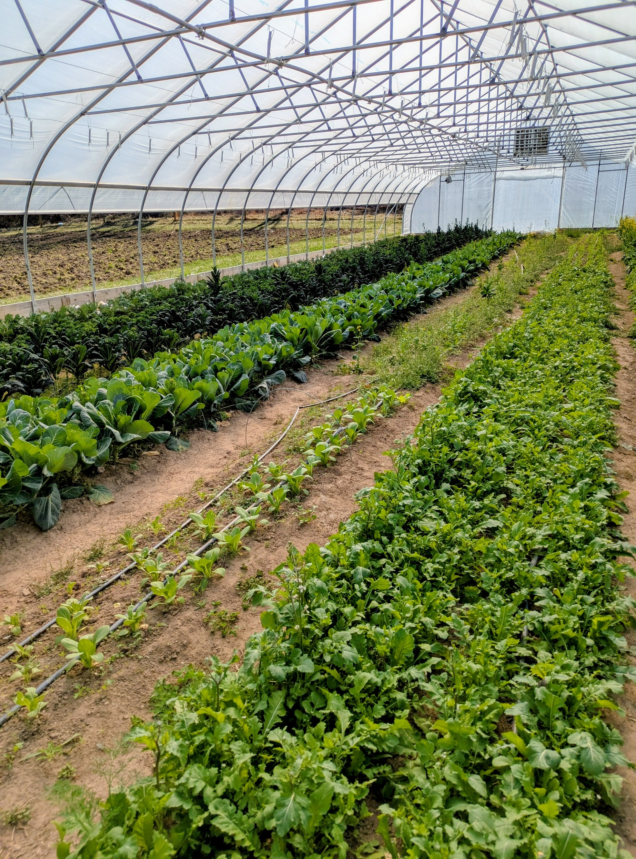
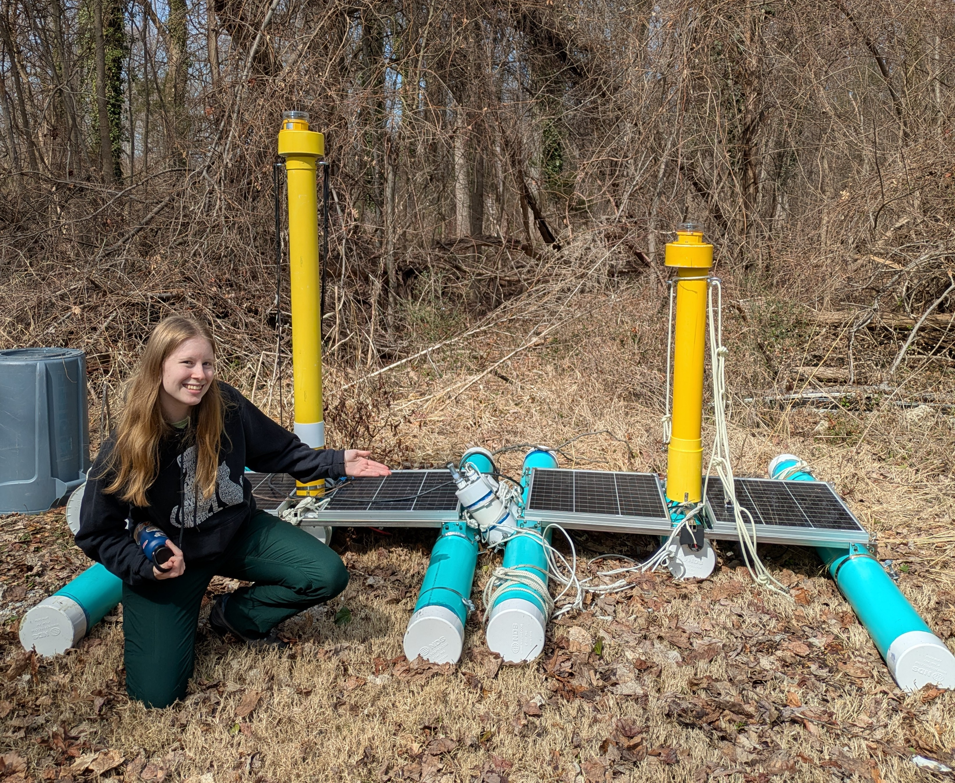
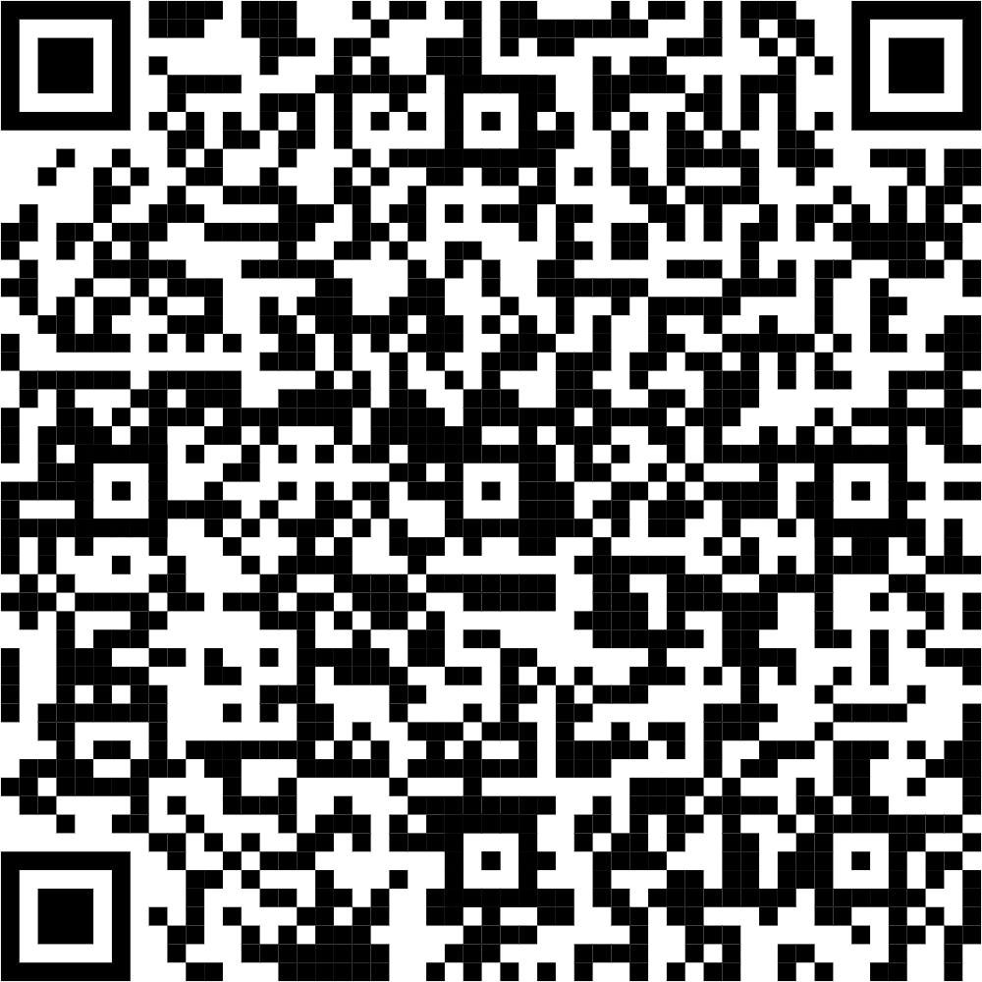
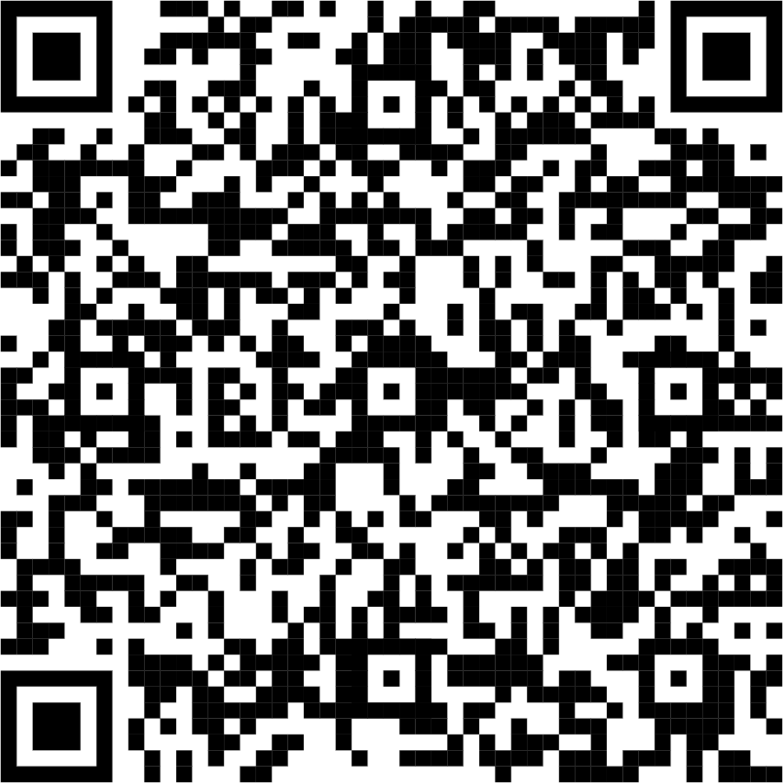
Oysters and Trees! Chesapeake Bay Service Learning
Maeve Kuipers
College Park Scholars – Science & Global Change Program
Biology: Ecology and Evolution
mkuipers@terpmail.umd.edu
CPSG240
College Park Scholars Academic Showcase, May 9, 2025
Site Information:
Chesapeake Bay Foundation
Address: Philip Merrill Environmental Center - 6 Herndon Ave, Annapolis, MD 21403
Site Supervisors: Andrej Radoja and Chloe Cartwright
The site mission: To save the Chesapeake Bay so that it is healthy and resilient for both animals and people to thrive together(Chesapeake Bay Foundation, 2025).
Activities:
Issues Confronting Site:
Nutrient Runoff From Agriculture:
Runoff from farms contains nutrients and sediment which make their way into the Chesapeake Bay. When levels of these nutrients, get too high, eutrophication events occur where algal blooms deplete the oxygen content of the Bay's waters, block sunlight for seagrasses, and release toxins into the water.
Low Oyster Population:
Since the days of colonization, the oyster population in the bay has dropped to 3% of its previous population(NOAA Fisheries, 2025). Oyster are a keystone species that provide habitat, filter sediment and nutrients from water, and protect against storm surge and erosion.
Potting, loading, and planting Native trees with Clagett Farm
Preparing recycled oyster shells to grow baby oysters for the Bay
Future Work: My volunteer work gave CBD staff time to dedicate to new projects!
Impact:
Made a meaningful contribution to oyster restoration and the fight against nutrient pollution in the Bay.
Learned about the economic, cultural, and ecological aspects of the problems facing the Chesapeake Bay.
The “Light Tunnel” mechanically adjusts its panels to keep its interior at a constant temperature, using the sun’s energy to grow food year round
These solar powered buoys play recorded healthy reef sounds to attract organisms to live in newly established oyster reefs
Acknowledgments:
I would like to thank:
My College Park Scholars professors, Dr. John Merck and Dr. Thomas Holtz
My fellow alternative break students, Cheyanne, Sage, and Bria.
My site supervisors/spring break leaders: Chloe Cartwright and Andrej Radoja
My Alternate Breaks faculty member: Jennifer Gunnulfsen
The Chesapeake Bay Foundation
CBF Staff: Adele Thrush, Jared Planz, and Will Grinnell
Bibliography
Testimonial Video
Space to place QR Code

