Slide 1
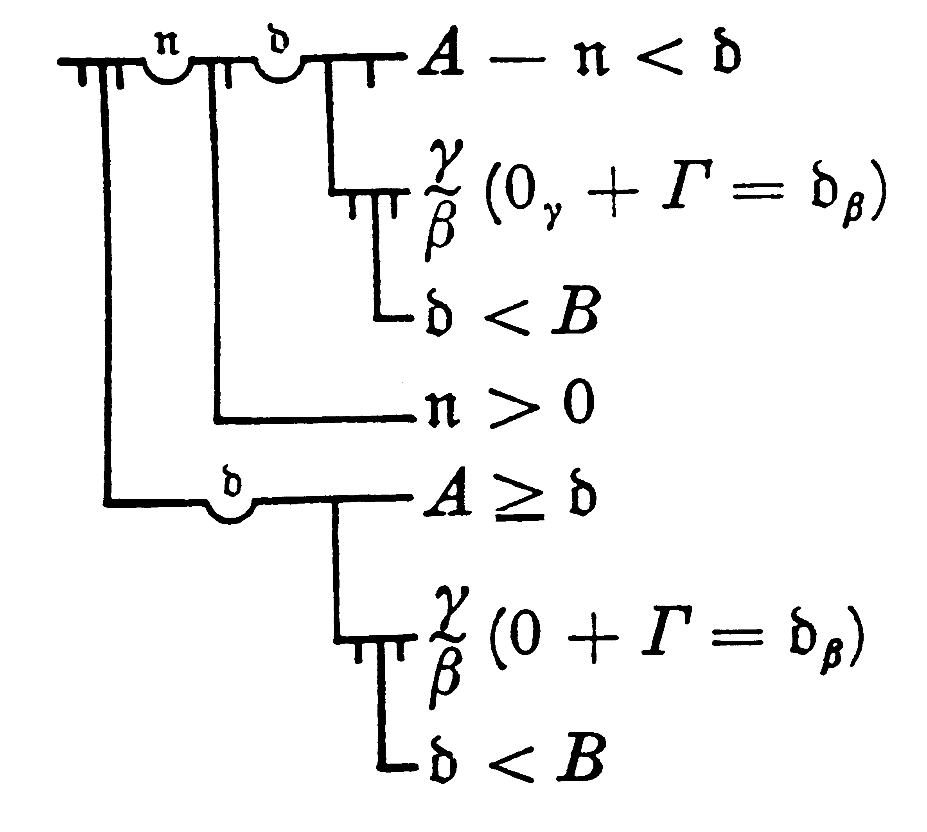
Fostering Liars
Paul M. Pietroski
Rutgers University
http://www.tinyurl.com/pietroski
(slides available there)

Slide 2
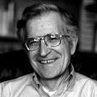
Languages: connect interpretations of some kind with signals of some kind
Slangs: spoken/signed languages that children can naturally acquire
Slangs connect meanings with pronunciations in ways
that are unbounded but also interestingly constrained.
the duck is ready to eat
the duck is ready to dine
the duck is pret-a-manger
the duck is eager to eat
the duck is eager to be one who eats
# the duck is eager to be one who is eaten
the duck is easy to eat
# It is easy for the duck to eat (some food)
It is easy (for us) to eat the duck
Languages
Slangs
one pronunciation,
two meanings
one meaning,
not two
one meaning,
not two

Slide 3
Languages: connect interpretations of some kind with signals of some kind
Slangs: spoken/signed languages that children can naturally acquire
Slangs connect meanings with pronunciations in ways
that are unbounded but also interestingly constrained.
the duck is ready to eat
the duck is ready to dine
the duck is pret-a-manger
the duck is eager to eat
the duck is eager to be one who eats
# the duck is eager to be one who is eaten
the duck is easy to eat
# It is easy for the duck to eat (some food)
It is easy (for us) to eat the duck
Languages
Slangs
one pronunciation,
two ways of
understanding it
one meaning,
not two
one meaning,
not two

Slide 4
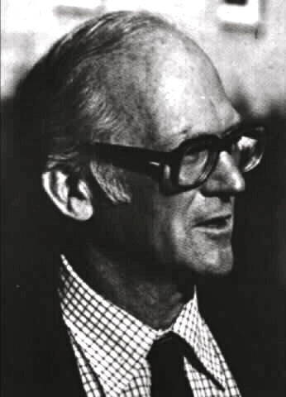
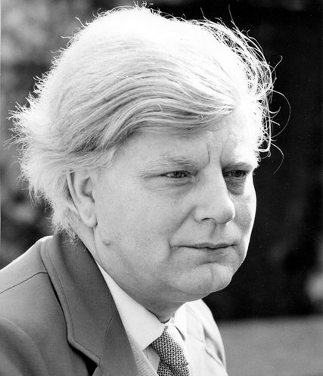
Davidson’s Conjecture:
for each Slang, S, there is a truth theory that is also
the core of an adequate theory of meaning for S
Dummett’s Questions:
What is a theory of meaning?
What is it a theory of?
What are we trying describe/explain?
Chomsky’s Facts:
There are interesting limits on how speakers of Slangs
can connect meanings with pronunciations.
We understand speech in human ways.

Slide 5
What is a Theory of Meaning for a Slang?
Dummett’s Suggestion (and Chomsky’s, and …, and mine)
• a theory of meaning is a theory of understanding
a partial theory of the linguistic competence
that certain human beings have acquired
• a theory of understanding won’t be a theory of truth
(different topics, explananda, and “governing laws”)
• one can hypothesize that a theory of understanding for a Slang
will include a truth theory—i.e., a theory whose theorems
specify truth conditions for the declarative sentences of the Slang
• but it’s bold to posit truth theories for Slangs
• it’s very bold to posit them as core components of meaning theories

Slide 6
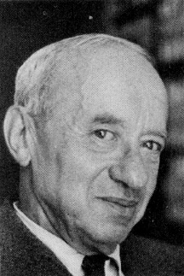
For today, let’s bracket many concerns about the Very Bold Conjecture…
polysemy, requisite ontology, difficulty of evaluating proposals
specific constructions, contextual dependence, vagueness
paucity of parade cases
evidence that meaning is compositional in ways that truth isn’t
…and focus on a pair of old concerns
Can there be true truth theories for languages that generate (1) and (2)?
(1) The first numbered sentence in this talk is not true.
(2) My favorite sentence is not true.
How can analogs of (3) help if there are equally true analogs of (4)?
(3) ‘Snow is white’ is true if and only if snow is white.
(4) ‘Snow is white’ is true if and only if e^{i𝝅} + 1 = 0.
Truth is representation-neutral in ways that meaning isn’t.
😐
John
Foster

Slide 7
Two Sides of a Major Problem
if a Slang sentence S has the truth-theoretic property ascribed
by a Davidsonian “T-sentence,” then given some truths,
S has the truth-theoretic properties ascribed by other T-sentences
In some cases, it seems that if S has the Davidsonian property ascribed to it,
then S has properties that are logically incompatible.
(1) The first numbered sentence is not true.
Prima facie, a Davidsonian truth/meaning theory for English will imply (1a).
(1a) relative to any context C,
True[(1)] ≡ ~True[the first numbered sentence in C]
(1b) relative to the actual context C*,
True[(1)] ≡ ~True[the first numbered sentence in C*] (1a)
(1) = first numbered sentence in C* fact
True[(1)] ≡ ~True[(1)] ⊥
That’s not a paradox. It’s an argument that (1a) is false.

Slide 8
Two Sides of a Major Problem
if a Slang sentence S has the truth-theoretic property ascribed
by a Davidsonian “T-sentence,” then given some truths,
S has the truth-theoretic properties ascribed by other T-sentences
In some cases, it seems that if S has the Davidsonian property ascribed to it,
then S has properties that are logically incompatible.
(1) The first numbered sentence is not true.
For any truth theory that initially looks plausible as a theory of meaning, many equally true truth theories are implausible as theories of meaning.
(3) ‘Snow is white’ is true if and only if snow is white. T-sentence
(F) Snow is white if and only if e^{i𝝅} + 1 = 0. T if snow is white
(4) ‘Snow is white’ is true if and only if e^{i𝝅} + 1 = 0. as true as (3)
Davidsonians need to say how a truth theory “of the right sort”
could ever be the core of a good theory of meaning for a Slang.

Slide 9
Rest of the Talk
Foster’s Problem
Standard Replies: Spare Axioms and Canonical Derivations
Retort: what’s the role of truth in a theory of meaning?
Liar Sentences
Standard Replies: Sophisticated Axioms and Clever Rules
Retorts: Spare and Sophisticated? Canonical and Clever?
Also, what’s the role of truth in a theory of meaning?
It’s hard to see how a plausible hypothesis about how expressions are truth-theoretically related to the world could do double-duty as a plausible hypothesis about how expressions are understood.
Truth is representation-neutral in ways that meaning isn’t.

Slide 10
Deriving T-sentences
(A1) ∀x[TrueOf(walks_{Verb}, x) ≡ Walks(x)]
(A2) ∀x[TrueOf(talks_{Verb}, x) ≡ Talks(x)]
(A3) ∀x[TrueOf(Ernie_{Name}, x) ≡ (x = Ernie)]
(A4) ∀x[TrueOf(Bert_{Name}, x) ≡ (x = Bert)]
(A5) True([…_{Name} …_{Verb}]_{Sentence})
≡ ∃x[TrueOf(…_{Name}, x) & TrueOf(…_{Verb}, x)]
(T1) True([Ernie_{Name} walks_{Verb}]_{Sentence})
≡ ∃x[TrueOf(Ernie_{Name} , x) & TrueOf(walks_{Verb}, x)]
≡ ∃x[ x = Ernie & Walks(x)]
Suppressing many complexities…
tense, event variables, polysemy, genericity, …

Slide 11
Deriving T-sentences
(A1) ∀x[TrueOf(walks_{Verb}, x) ≡ Walks(x)]
(A2) ∀x[TrueOf(talks_{Verb}, x) ≡ Talks(x)]
(A3) ∀x[TrueOf(Ernie_{Name}, x) ≡ (x = Ernie)]
(A4) ∀x[TrueOf(Bert_{Name}, x) ≡ (x = Bert)]
(A5) True([…_{Name} …_{Verb}]_{Sentence})
≡ ∃x[TrueOf(…_{Name}, x) & TrueOf(…_{Verb}, x)]
(T2) True([Bert_{Name} talks_{Verb}]_{Sentence})
≡ ∃x[TrueOf(Bert_{Name} , x) & TrueOf(talks_{Verb}, x)]
≡ ∃x[ x = Bert & Talks(x)]
Parallel theorems for [Bert_{Name} walks_{Verb}]_{Sentence}
and [Ernie_{Name} talks_{Verb}]_{Sentence}

Slide 12
Deriving Unwanted T-sentences
Let T be any true sentence—e.g., ‘Bert talks’ or ‘e^{i𝝅} + 1 = 0’
or ‘∃x[x = Bert & Talks(x)]’
or ‘True([Bert_{Name} talks_{Verb}]_{Sentence}) ≡ ∃x[x = Bert & Talks(x)]’
(A1*) ∀x[TrueOf(walks_{Verb}, x) ≡ T & Walks(x)]
(A3) ∀x[TrueOf(Ernie_{Name}, x) ≡ (x = Ernie)]
(A5) True([…_{Name} …_{Verb}]_{Sentence})
≡ ∃x[TrueOf(…_{Name}, x) & TrueOf(…_{Verb}, x)]
(T1*) True([Ernie_{Name} walks_{Verb}]_{Sentence})
≡ ∃x[TrueOf(Ernie_{Name} , x) & T & TrueOf(walks_{Verb}, x)]
≡ ∃x[ x = Ernie & T & Walks(x)]

Slide 13
Deriving Unwanted T-sentences
Let T be any true sentence—e.g., ‘Bert talks’ or ‘e^{i𝝅} + 1 = 0’
or ‘∃x[x = Bert & Talks(x)]’
or ‘True([Bert_{Name} talks_{Verb}]_{Sentence}) ≡ ∃x[x = Bert & Talks(x)]’
(A1) ∀x[TrueOf(walks_{Verb}, x) ≡ Walks(x)]
(A3*) ∀x[TrueOf(Ernie_{Name}, x) ≡ T & (x = Ernie)]
(A5) True([…_{Name} …_{Verb}]_{Sentence})
≡ ∃x[TrueOf(…_{Name}, x) & TrueOf(…_{Verb}, x)]
(T1*) True([Ernie_{Name} walks_{Verb}]_{Sentence})
≡ ∃x[TrueOf(Ernie_{Name} , x) & T & TrueOf(walks_{Verb}, x)]
≡ ∃x[ x = Ernie & T & Walks(x)]

Slide 14
Deriving Unwanted T-sentences
Let T be any true sentence—e.g., ‘Bert talks’ or ‘e^{i𝝅} + 1 = 0’
or ‘∃x[x = Bert & Talks(x)]’
or ‘True([Bert_{Name} talks_{Verb}]_{Sentence}) ≡ ∃x[x = Bert & Talks(x)]’
(A1) ∀x[TrueOf(walks_{Verb}, x) ≡ Walks(x)]
(A3) ∀x[TrueOf(Ernie_{Name}, x) ≡ (x = Ernie)]
(A5*) True([…_{Name} …_{Verb}]_{Sentence})
≡ ∃x[TrueOf(…_{Name}, x) & T & TrueOf(…_{Verb}, x)]
(T1*) True([Ernie_{Name} walks_{Verb}]_{Sentence})
≡ ∃x[TrueOf(Ernie_{Name} , x) & T & TrueOf(walks_{Verb}, x)]
≡ ∃x[ x = Ernie & T & Walks(x)]

Slide 15
Deriving Unwanted T-sentences
(A1) ∀x[TrueOf(walks_{Verb}, x) ≡ Walks(x)]
(A3) ∀x[TrueOf(Ernie_{Name}, x) ≡ (x = Ernie)]
(A5) True([…_{Name} …_{Verb}]_{Sentence})
≡ ∃x[TrueOf(…_{Name}, x) & TrueOf(…_{Verb}, x)]
Let T be a theorem of some true theory
(T1) True([Ernie_{Name} walks_{Verb}]_{Sentence})
≡ ∃x[TrueOf(Ernie_{Name} , x) & TrueOf(walks_{Verb}, x)]
≡ ∃x[ x = Ernie & Walks(x)]
* ≡ ∃x[ x = Ernie & Walks(x)] & T
What makes the “special” axioms and derivations special?

Slide 16
Spare Axioms, Canonical Derivations
Even if T is a theorem of some true theory…
(A1) ∀x[TrueOf(walks_{Verb}, x) ≡ T & Walks(x)]
(A3) ∀x[TrueOf(Ernie_{Name}, x) ≡ T & (x = Ernie)]
(A5) True([…_{Name} …_{Verb}]_{Sentence})
≡ ∃x[TrueOf(…_{Name}, x) T & TrueOf(…_{Verb}, x)]
(T1) True([Ernie_{Name} walks_{Verb}]_{Sentence})
≡ ∃x[TrueOf(Ernie_{Name} , x) & TrueOf(walks_{Verb}, x)]
≡ ∃x[x = Ernie & Walks(x)]
* ≡ ∃x[x = Ernie & Walks(x)] & T
* ≡ Walks(Ernie)
⊢ True(S) ≡ p
S means that p
Ernie walks means that
∃x[x = Ernie & Walks(x)]

Slide 17
Spare Axioms?
✓ ∀x[TrueOf(Venus_{Name}, x) ≡ (x = Venus)]
* ∀x[TrueOf(Hesperus_{Name}, x) ≡ (x = Phosphorus)]
* ∀x[TrueOf(Hesperus_{Name}, x) ≡
(x = Hesperus) & (Hesperus = Phosphorus)]
✓ ∀x[TrueOf(groundhog_{Noun}, x) ≡ x is a groundhog]
* ∀x[TrueOf(groundhog_{Noun}, x) ≡ x is a woodchuck]
* ∀x[TrueOf(groundhog_{Noun}, x) ≡ x is a whistlepig]
* ∀x[TrueOf(woodchuck_{Noun}, x) ≡ x is a whistlepig]

Slide 18
Spare Axioms?
True(⎡𝛂 and 𝛃⎤) ≡ True(⎡𝛂⎤) & True(⎡𝛃⎤)
‘Ernie walks and Bert talks’ means that
∃x[x = Ernie & Walks(x)] & ∃x[x = Ernie & Walks(x)]
P Q P&Q ~P ~Q P↓Q P↓P Q↓Q (P↓P)↓(Q↓Q)
1 1 1 0 0 0 0 0 1
1 0 0 0 1 0 0 1 0
0 1 0 1 0 0 1 0 0
0 0 0 1 1 1 1 1 0
True(⎡𝛂 and 𝛃⎤) ≡ [True(⎡𝛂⎤) ↓ True(⎡𝛂⎤)] ↓ [True(⎡𝛃⎤) ↓ True(⎡𝛃⎤)]
‘Ernie walks and Bert talks’ means that
{∃x[x = Ernie & Walks(x)] ↓ ∃x[x = Ernie & Walks(x)]} ↓
{∃x[x = Bert & Talks(x)] ↓ ∃x[x = Bert & Talks(x)]}
⊢ True(S) ≡ p
S means that p

Slide 19
“Sensy” Axioms, Canonical Derivations
✓ True(⎡𝛂 and 𝛃⎤) ≡ True(⎡𝛂⎤) & True(⎡𝛃⎤)
* True(⎡𝛂 and 𝛃⎤) ≡ [True(⎡𝛂⎤) ↓ True(⎡𝛂⎤)] ↓ [True(⎡𝛃⎤) ↓ True(⎡𝛃⎤)]
✓ ∀x[TrueOf(Venus_{Name}, x) ≡ (x = Venus)]
* ∀x[TrueOf(Hesperus_{Name}, x) ≡ (x = Phosphorus)]
True([Venus_{Name} shines_{Verb}]_{Sentence})
≡ ∃x[TrueOf(Venus_{Name} , x) & TrueOf(shines_{Verb}, x)]
≡ ∃x[x = Venus & Shines(x)]
* ≡ ∃x[x = Venus & Shines(x)] & T
* ≡ Shines(Venus)
Larson & Segal: heavily blinkered (anti-omniscient) rules
R1. Axiom Instantiation
R2. if ⊢ …𝝫(x)… and ⊢ 𝝫(x) ≡ 𝚿(x), then ⊢ …𝚿(x)…
a few other rules

Slide 20
“Sensy” Axioms, “Sensy” Derivations
TrueOf([what₁ [Bert saw t_{i}]_{Sentence}]_{RelClause}, x) ≡ Bert saw x
Relative to any assignment A of values to variables…
TrueOf([what₁ [Bert saw t₁]_{Sentence}]_{RelClause}, x) ≡
(a) for some assignment A* such that A* ≈₁ A & A*(1) = x,
[Bert saw t₁]_{Sentence} is true relative to A*
(b) for some assignment A* such that A* ≈₁ A & A*(1) = x,
some event prior to A*(time) is an event of Bert seeing A*(1)
(c) for some assignment A* such that A* ≈₁ A & A*(1) = x,
some event prior to A(time) is an event of Bert seeing x
(d) some event prior to A(time) is an event of Bert seeing x
Is this derivation canonical?
How does this differ from an “untruthy” mentalistic proposal?

Slide 21
Meanings as Instructions for How to Build Concepts
* Hesperus_{Name} ➔ Hesperus & =(Hesperus, Phosphorus)
* Hesperus_{Name} ➔ Phosphorus
✓ Hesperus_{Name} ➔ Hesperus
✓ France_{Name} ➔ France_{place}, … , France_{polis}
✓ [France_{Name} [is hexagonal]_{VerbPhrase}]_{Sentence} ➔
∃x[=(x, ➔{France_{Name}}) & ➔ [is hexagonal]_{VerbPhrase}(x)] ➔
∃x[=(x, France_{place}) & hexagonal(x)]
∃x[=(x, France_{polis}) & hexagonal(x)]
✓ [France_{Name} [is a republic]_{VerbPhrase}]_{Sentence} ➔
∃x[=(x, ➔{France_{Name}}) & ➔ [is hexagonal]_{VerbPhrase}(x)] ➔
∃x[=(x, France_{place}) & republic(x)]
∃x[=(x, France_{polis}) & republic(x)]
London/Londres
Jerusalem/al-Quds

Slide 22
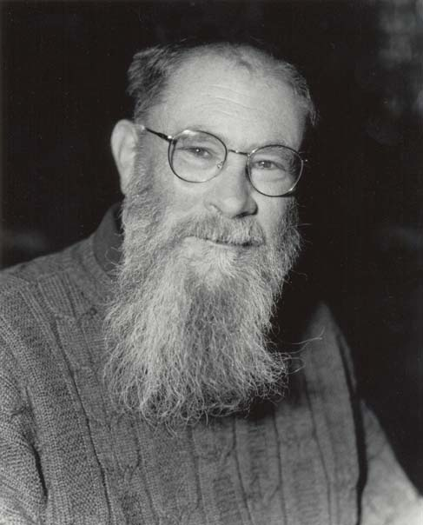
Meanings as Instructions for How to Build Concepts
* Hesperus_{Name} ➔ Hesperus & =(Hesperus, Phosphorus)
* Hesperus_{Name} ➔ Phosphorus
✓ Hesperus_{Name} ➔ Hesperus
✓ France_{Name} ➔ France_{place}, … , France_{polis}
✓ [what₁ [Bert saw t₁]_{Sentence}]_{RelClause} ➔ … ➔
∃e[before(e, A(time)) & SeeingByOf(e, bert, x)]
You can stipulate
that this isn’t a
“real semantics”
But then maybe
a theory of meaning
(for a Slang) isn’t a
“real semantics”
if Davidsonians reject this mentalistic conception of meaning as inadequate,
they need to say how insisting on “one word, one extension”
with “sensy” axioms and canonical derivations is better.

Slide 23
Recall: Two Sides of a Major Problem
if a Slang sentence S has the truth-theoretic property ascribed
by a Davidsonian “T-sentence,” then given some truths,
S has the truth-theoretic properties ascribed by other T-sentences
In some cases, it seems clear that if S has a Davidsonian property,
then S has properties that are logically incompatible.
For any truth theory that initially looks plausible as a theory of meaning, endlessly many equally true theories are implausible as theories of meaning.
In short, Davidsonians need a “logic” for deriving theorems that is…
Clever Enough to not yield contradictions given Liar Sentences, and yet
Dumb Enough to not generate theorems that trigger Foster’s Problem

Slide 24
Back to the First Side of a Major Problem
if a Slang sentence S has the truth-theoretic property ascribed
by a Davidsonian “T-sentence,” then given some truths,
S has the truth-theoretic properties ascribed by other T-sentences
In some cases, it seems clear that if S has a Davidsonian property,
then S has properties that are logically incompatible.
(1) The first numbered sentence is not true.
(1a) relative to any context C,
True[(1)] ≡ ~True[the first numbered sentence in C]
(1b) relative to the actual context C*,
True[(1)] ≡ ~True[the first numbered sentence in C*]
the first numbered sentence in C* = (1)
True[(1)] ≡ ~True[(1)]
That’s not a paradox. It’s an argument that (1a) is false.
And if (1) is not true, then my/your/our thought that (1) is not true is true.

Slide 25
Back to the First Side of a Major Problem
if a Slang sentence S has the truth-theoretic property ascribed
by a Davidsonian “T-sentence,” then given some truths,
S has the truth-theoretic properties ascribed by other T-sentences
In some cases, it seems clear that if S has a Davidsonian property,
then S has properties that are logically incompatible.
(2) My favorite sentence is not true.
(2a) relative to any context C, truthy
True[(2)] ≡ ~True[the favorite sentence of C(speaker)] conjecture
(2b) relative to the actual context C*,
True[(2)] ≡ ~True[the favorite sentence of C*(speaker)] (2a)
(2) = the favorite sentence of C*(speaker) (fact)
True[(2)] ≡ ~True[(2)] ⊥
That’s not a paradox. It’s an argument that (2a) is false.

Slide 26
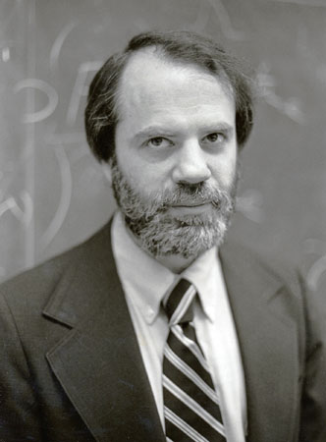
Pervasive Liars
(6) Most of the sentences in there₁ are not true.
(7) Most of the sentences in Boxy are not true.
(D) relative to any context C,
True[(6)] ≡ Most of the sentences in C(1) are not true
True[(7)] ≡ Most of the sentences in Boxy are not true
(K) relative to the actual context C*,
--C*(1) is a box that contains nine sentences:
four true ones (e.g., ‘1 =1’)
four false ones (e.g., ‘1 =2’)
‘Most of the sentences in Boxy are not true’
--so given (D), True[(6)] ≡ ~True[(7)]
--C*(1) = Boxy
--so given (D), True[(6)] ≡ True[(7)]
That’s not a paradox. It’s an argument that hypothesis (D) is false.
Notes:
CHECK TIME

Slide 27
Sophisticated Axioms and Clever Rules?
You can hypothesize that true isn’t like blue
∀x[TrueOf(blue_{Adjective}, x) ≡ Blue(x)]
~∀x[TrueOf(true_{Adjective}, x) ≡ True(x)]
--Kripke-style Hierarchies with Fixed Points
--Gupta-Belnap Revisions
--Your Favorite Proposal here: for any sentence S, True(S) ≡ …
But why think the axioms and rules for deriving theorems will be
suitably “sensy” and yield canonical (meaning –specifying) theorems?
Moreover, the Slang adjective true is not a sentential operator like ‘’
P P ~P
1 1 0
0 0 1
Not even not is a sentential operator
(8) It is true that snow is not green.
(9) It isn’t true that snow is green.
Notes:
AT THIS POINT, CHECK TIME AND SKIP TO END

Slide 28
Sophisticated Axioms and Clever Rules?
There are endlessly many sentences like (2) and (10).
(10) That sentence is true.
(11) No true sentence in that box contains nine words.
So we still need Foster-appropriate axioms of some kind.
∀x[TrueOf(blue_{Adjective} , x) ≡ Blue(x)]
∀x[TrueOf([is …_{Adjective}]_{VerbPhrase} , x) ≡ TrueOf(…_{Adjective} , x)]
∀x[TrueOf([is true???]_{VerbPhrase} , x) ≡ ???]
∀x[TrueOf([…_{Adj} …_{Noun}]_{NounPhrase}), x) ≡ TrueOf(…_{Noun}, x)] & TrueOf(…_{Adj} , x)
∀x[TrueOf([true??? …_{Noun}]_{NounPhrase}, x) ≡ TrueOf(…_{Noun}, x) & ??? ]

Slide 29
Radical Reply 1 (time permitting): “Don’t Worry about Liars” a Truth Theory for a Fragment of a Slang can be good enough
A full response would require a discussion of what Slangs are. But in any case, why think the ordinary words blue and true differ in kind?
we can use true to vividly illustrate a certain objection to the VBC
examples with blue don’t illustrate the objection in the same way
but don’t confuse epistemology with conclusions
an impoverished lexicon will fail to illustrate many problems for the VBC
but why think that with regard to meaning/understanding,
is true and true sentence are special, compared with
is blue and blue string?
if we bracket fake diamond and thinks that Venus is Phosphorus, we owe reasons for treating these constructions as special
ignoring words that illustrate objections is no defense of the VBC
to evaluate combinatorial axioms, we need to see what they imply
Notes:
SKIP TO SAVE TIME

Slide 30
Radical Reply 2 (time permitting): “Don’t Worry about Liars” a false Truth Theory for a Slang can be good enough
A full discussion would require a longer talk. But for 50+ years,
the line has been that endlessly many biconditionals like (12) are true, and that these truths are explananda for theories of meaning.
(12) True([Ernie_{Name} walks_{Verb}]_{Sentence}) ≡ ∃x[x = Ernie & Walks(x)]
But if we don’t have to explain why biconditionals like (12) are true,
why think truth plays a special role in theories of meaning?
And in what ways is it OK for a proposed truth theory to be false?
What counts as getting it wrong in semantics?
If theorems like (12) are merely “interpretive”—in that their right sides provide “decent regimentations” of the Slang sentences—why not omit talk of truth, and view the right sides as proposed “mental translations”?
Notes:
SKIP IF SHORT ON TIME

Slide 31
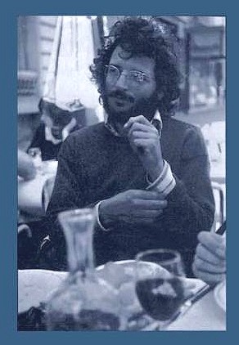
Once upon a time, the Very Bold Conjecture was a very bold conjecture, as opposed to a dogmatic ground rule.
Advocates worried about extensionally equivalent theories; and at least some of them worried about Liar Sentences.

Slide 32
Once upon a time, the Very Bold Conjecture was a very bold conjecture, as opposed to a dogmatic ground rule. Advocates worried about extensionally equivalent theories; and at least some of them worried about Liar Sentences.
It has become standard to ignore these issues. But thinking about Foster’s Problem and Liar Sentences together
highlights an old (and perhaps fatal) objection to the VBC:
It’s hard to see how any plausible hypothesis about how expressions are truth-theoretically related to the world can do double-duty as a plausible hypothesis
about how expressions are understood.
for each Slang, S,
there is a truth theory that is also
the core of an adequate
theory of meaning for S
a theory of meaning/understanding
is a partial theory of a competence acquired by certain humans; and
the competence is not truth-theoretic

Slide 33
Once upon a time, the Very Bold Conjecture was a very bold conjecture, as opposed to a dogmatic ground rule. Advocates worried about extensionally equivalent theories; and at least some of them worried about Liar Sentences.
It has become standard to ignore these issues. But thinking about Foster’s Problem and Liar Sentences together
highlights an old (and perhaps fatal) objection to the VBC:
it’s hard to see how any plausible hypothesis about how expressions are truth-theoretically related to the world can do double-duty as a plausible hypothesis
about how expressions are understood.
So let’s not confuse theories of how expressions are understood with theories of what it is for uses of sentences (Slang or Mental) to be true.
And let’s admit that externalist constraints on truth/reference
need not be constraints on meaning/understanding.

Slide 34
Thanks

Slide 35
For Specialists: Bracketing a Distraction (to Save Time)
if a Slang sentence S has the truth-theoretic property ascribed
by a Davidsonian “T-sentence,” then given some truths,
S has the truth-theoretic properties ascribed by other T-sentences
Don’t confuse Onto-Logically Fancy theories of truth/meaning for Slangs…
TRUE-IFF(‘Snow is white’, 𝜮𝕵𝕽𝖁𝝽)
𝜮𝕵𝕽𝖁𝝽 ≡ e^{i𝝅} + 1 = 0
~TRUE-IFF(‘Snow is white’, e^{i𝝅} + 1 = 0)
…with “truth-maker” proposals regarding invented (or mental) languages.
If neo-Davidsonians also posit a “logic” for fine-grained contents, they need to say why the net result is a plausible truth theory for a Slang—as opposed to an algorithm that pairs Slang expressions with mental representations.
And in my view, positing representation-neutral contents doesn’t help.

Slide 36
(13) No true sentence in Ziggy has eight words.
Ziggy contains nine sentences, one of which is (13)
four true ones, none of which has eight words (e.g., ‘1 = 1’)
four false ones, none of which has eight words (e.g., ‘1 = 2’)
‘No true sentence in Ziggy has eight words’
If (13) is true, then one true sentence in Ziggy has eight words.
But if (13) is true, then no true sentence in Ziggy has eight words.
So (13) isn’t true, and no true sentence in Ziggy has eight words;
So if (13) is true iff no true sentence in Ziggy has eight words,
then (13) is true--and hence, (13) is both true and not true;
So it’s not true that (13) is true iff no true sentence in Ziggy has eight words.
-----------------------------------------------------------------------------------------------
(14) Most of the sentences in Ziggy are not true.
(6) Most of the sentences in there₁ are not true.
(7) Most of the sentences in Lari are not true.
It’s true that most of sentences in Ziggy are not true.
But it doesn’t follow that (14) has a truth condition; recall (6), (7), and (13).

Slide 37
(1) This sentence is not true
if in the actual context C*, this sentence is used to think about (1), then in C*, an affirmative use of ~[true(this sentence)] is true.
(2) My favorite sentence is not true
if in the actual context C*, my favorite sentence is used to think about (2), then in C*, an affirmative use of ~[true(my favorite sentence)] is true.
(3) This utterance is not true
if in C*, this utterance is used to think about the utterance of (3) in C*, then in C*, an affirmative use of ~[true(this utterance)] is true.
(4) This use of this mental sentence is not true.
if in C*, this use of this mental sentence is used to think about the episode e of my affirmatively using the corresponding mental sentence, then in C*, my affirmative use u of ~[true(this use of this mental sentence)] is not true.
For u is e, and e is not true. (If e is true, it is both true and not true.) So there is no sound route to the conclusion that u is true. And it’s false that ~[true(this use of this mental sentence)] is true relative to C* iff u is not true.
For a use of a mental sentence to be truth-evaluable—or if you prefer, for a context to be legitimate (non-defective)—the world has to cooperate. The mental sentence this use of this mental sentence is not true has a character that does not map each situation to truth or falsity.

Slide 38
Between Meaning and Truth
Slang expressions are not themselves truth-evaluable.
But a Slang sentence connects a pronunciation p with meaning m
that can be used to build a Mental Sentence (thought).
Affirmative uses of Mental Sentences can be true or false.
But the details are complicated.
Utterances of Slang sentences can be true or false.
But the details are more complicated.
Don’t race in with forensic questions about what speakers are committed to.

Slide 39
if ||pigs talk nad quails fly|| = T iff pigs talk & quails fly,
then ||pigs talk nad quails fly|| = T iff (pigs talk ↓ pigs talk) ↓ (quails fly ↓ quails fly)
= T iff (pigs talk | quails fly) | (pigs talk | quails fly)
if ||ont pigs talk|| = T iff ~(pigs talk),
then ||ont pigs talk|| = T iff (pigs talk ↓ pigs talk)
= T iff (pigs talk | pigs talk)
if ||pigs talk orn quails fly|| = T iff ~(pigs talk) & ~(quails fly),
then ||pigs talk orn quails fly|| = T iff (pigs talk ↓ quails fly)
if ||my favorite sentence is not true||^{A} = T iff ~True{FAVE[A(s)]},
and A(s) = Pietroski, and FAVE[Pietroski] = my favorite sentence is not true,
then FAVE[A(s)] = my favorite sentence is not true,
and hence, True{FAVE[A(s)]} & ~True{FAVE[A(s)]

Slide 40
Actually, Three Sides of an Overgeneration Problem
It’s not enough to provide a theory pairs each declarative sentence S with a true theorem of the form ‘True(S) ≡ p’ or ‘TrueRelativeTo(S, c) ≡ F(c)’.
The truth theory has to reflect how the sentences are understood.
But if the theory yields false theorems, that’s also a problem.
And theorists can misdescribe a language in many ways.
My favorite sentence is not true.
True(2) ≡ ~True(2)
(15) the duck is eager to eat
(15a) the duck is eager to be one who eats
(15b) the duck is eager to be one who is eaten
In virtue of what is it false that (15) has both meanings?

Slide 41
Languages: connect interpretations of some kind with signals of some kind.
Slangs: spoken or signed languages that children can naturally acquire
Slangs connect “meanings” with “pronunciations”
in ways that are unbounded but also interestingly constrained.
a magician saw an astronomer with binoculars
a magician saw an astronomer who had binoculars
a magician saw an astronomer by using binoculars
a magician saw an astronomer and had binoculars
Acquiring a Slang is a matter of acquiring a procedure
that generates certain meaning-pronunciation pairs, but not others.
two meanings,
not three

Slide 42
Object Language: P Q P nad Q ont P P orn Q
1 1 1 0 0
1 0 0 0 0
0 1 0 1 0
0 0 0 1 1
Metalanguage:
P Q P&Q ~P ~Q P↓Q P↓P Q↓Q (P↓P)↓(Q↓Q) PvQ (P↓Q)↓(P↓Q)
1 1 1 0 0 0 0 0 1 1 1
1 0 0 0 1 0 0 1 0 1 1
0 1 0 1 0 0 1 0 0 1 1
0 0 0 1 1 1 1 1 0 0 0
P Q P&Q ~P ~Q P|Q P|P Q|Q ((P|Q)|(P|Q)) PvQ ((P|P)|(Q|Q))
1 1 1 0 0 0 0 0 1 1 1
1 0 0 0 1 1 0 1 0 1 1
0 1 0 1 0 1 1 0 0 1 1
0 0 0 1 1 1 1 1 0 0 0
λP.~P = λP. P↓P
= λP. P|P
λP.λQ.P&Q
= λP.λQ. (P↓P)↓(Q↓Q)
= λP.λQ.((P|Q)|(P|Q))

Slide 43
Object Language: P Q P nad Q ont P P orn Q
1 1 1 0 0
1 0 0 0 0
0 1 0 1 0
0 0 0 1 1
Metalanguage:
P Q P&Q ~P ~Q P↓Q P↓P Q↓Q (P↓P)↓(Q↓Q) PvQ (P↓Q)↓(P↓Q)
1 1 1 0 0 0 0 0 1 1 1
1 0 0 0 1 0 0 1 0 1 1
0 1 0 1 0 0 1 0 0 1 1
0 0 0 1 1 1 1 1 0 0 0
P Q P&Q ~P ~Q P|Q P|P Q|Q ((P|Q)|(P|Q)) PvQ ((P|P)|(Q|Q))
1 1 1 0 0 0 0 0 1 1 1
1 0 0 0 1 1 0 1 0 1 1
0 1 0 1 0 1 1 0 0 1 1
0 0 0 1 1 1 1 1 0 0 0
if ||nad|| = λP.λQ.P&Q,
then ||nad|| = λP.λQ.(P↓P)↓(Q↓Q)
= λP.λQ.((P|Q)|(P|Q))
if ||ont|| = λP.~P,
then ||ont|| = λP. P↓P = λP. P|P
if ||orn|| = λP.λQ.~P&~Q, then ||orn||= λP.λQ.(P↓Q)

Slide 44
e^{ix} = cosine(x) + i[sine(x)]
where the argument to the trigonometric functions is given in radians
so
e^{i𝝅} = cosine(𝝅) + i[sine(𝝅)]
= –1 + i[0]
= –1
so
e^{i𝝅} + 1 = 0

