Slide 1
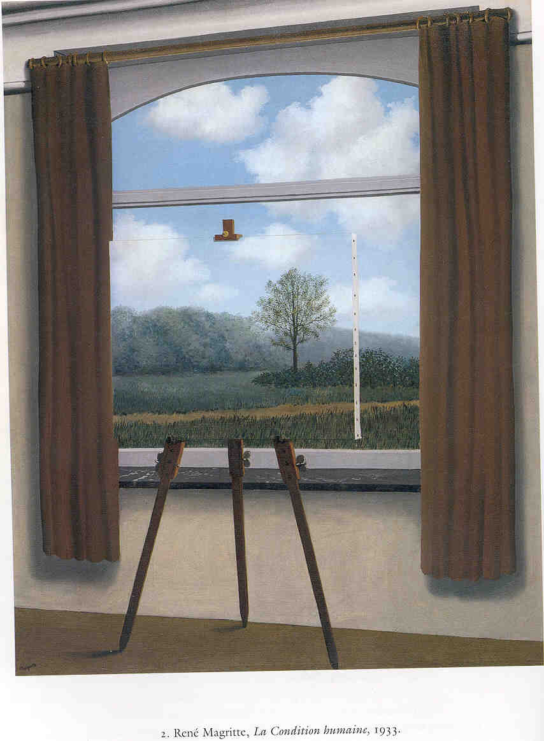
Mostly Framing
Paul M. Pietroski
University of Maryland
Dept. of Linguistics, Dept. of Philosophy

Slide 2
Outline
Framing effects
  may reveal laziness or puzzles
  but also tell us something about representational format
Some collaborative work on the meaning of ‘most’
  review some published results, but framed in terms of framing
  present some newer work, also framed this way
As time permits, some collaborative work in progress on…
  comparison: ‘more’ vs. ‘most’
  plural superlatives: ‘The red circles are the biggest’

Slide 3
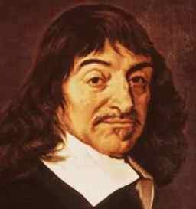
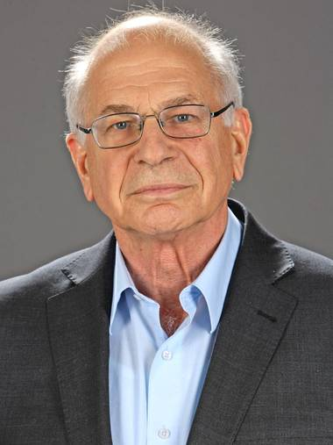
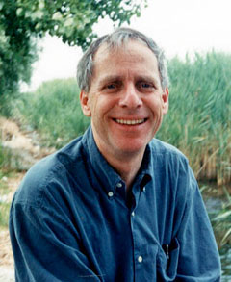
I Cognize, ergo
I am prone to Framing Effects
Examples via Kahneman’s recent book, Thinking Fast and Slow
A bat and a ball cost $1.10
The bat costs a dollar more than the ball
How much does the ball cost?
NOT ten cents…a dollar is not a dollar more than ten cents
Adam and Beth drive equal distances in a year.
Adam switches from a 12-mpg to 14-mpg car.
Beth switches from a 30-mpg to 40-mpg car.
Who will save more gas?
Adam: 10,000/12 = 833 10,000/14 = 714 saving of 119 gallons
Beth: 10,000/30 = 333 10,000/40 = 250 saving of 83 gallons

Slide 4
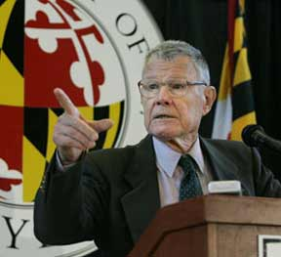
Schelling Effect
Suppose your tax depends on your income and how many kids you have.
The “child deduction” might be flat, say 1000 per child
Tax(i, k) = Base(i) – [k • 1000]
Or it might depend on the taxpayer’s income
Tax(i, k) = Base(i) – [k • Deduction(i)]
Q1: Should the child deduction be larger for the rich than for the poor?
Instead of taking the “standard” household to be childless,
we could lower the base tax for every household (e.g., by 3000), and
add a surcharge for households with less than 3 kids (e.g., 3000/2000/1000).
We could also let the surcharge depend on income.
Tax(i, k) = LowerBase(i) + [(3 – k) • Surcharge(i)]
Q2: Should the childless poor pay as large a surcharge as the childless rich?

Slide 5
Schelling Effect
Q1: Should the child exemption be larger for the rich than for the poor?
Q2: Should the childless poor pay as large a surcharge as the childless rich?
if you answered ‘No’ to both, then you are not endorsing a coherent policy
as Kahneman puts the point…
the difference between the tax owed by
a childless family and by a family with two children
can be described as a reduction or as an increase
if you want the poor to receive at least the
same benefit as the rich for having children,
then you must want the poor to pay at least the
same penalty as the rich for being childless.

Slide 6
1. ~[Deduction(r) > Deduction(p)] Desire
2. Surcharge(p) < Surcharge(r) Desire
3. for any income i,
Surcharge(i) = Deduction(i) obvious, but also provable
4. Surcharge(r) = Deduction(r) [3]
5. Surcharge(p) < Deduction(r) [2, 4]
6. Surcharge(p) = Deduction(p) [3]
7. Deduction(p) < Deduction(r) [5, 6]
8. Deduction(r) > Deduction(p) [7]
9. ⊥ [1, 8]

Slide 7
Kahneman’s Conclusion
“The message about the nature of framing is stark: framing should not be viewed as an intervention that masks or distorts an underlying preference. At least in this instance...there is no underlying preference that is masked or distorted by the frame. Our preferences are about framed problems, and our moral intuitions are about descriptions, not substance.”
Perhaps things aren’t always this bad. But sometimes, robust
“intuitions” reflect the format of mental representations,
as opposed to some representation-neutral content.
Theories that are (dis)confirmed by such intuitions may be
theories of how—rather than what—the intuiters represent
Notes:
Cp. Prospect Theory

Slide 8

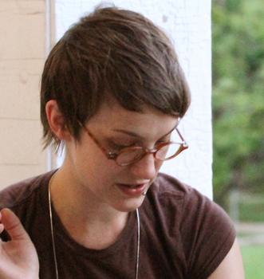
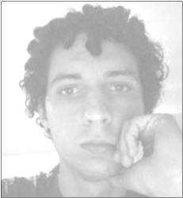
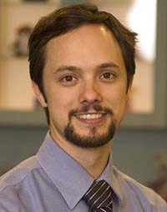

Tim
Hunter
A W
l e
e l
x l
i w
s o
o
d
Darko
Odic
J
e
f
f
L
i
d
z
Justin Halberda

Slide 9
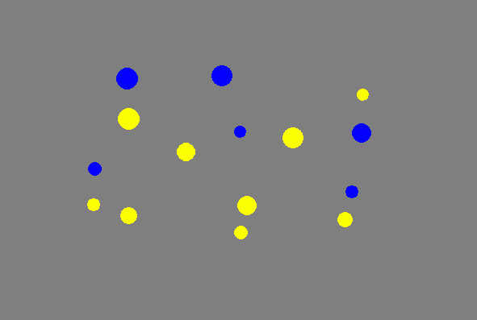
Most of the dots are yellow?
15 dots:
9 yellow
6 blue
How is the interrogative sentence understood?
What question is getting asked?
Notes:
1 to 2 SUPER EASY

Slide 10
‘Most of the dots are yellow’
MOST[DOT, YELLOW]
#{DOT & YELLOW} > #{DOT}/2
More than half of the dots are yellow (9 > 15/2)
#{DOT & YELLOW} > #{DOT & ∼YELLOW}
The yellow dots outnumber the nonyellow dots (9 > 6)
#{DOT & YELLOW} > #{DOT} – #{DOT & YELLOW}
The number of yellow dots exceeds
the number of dots minus the number of yellow dots
(9 > 15 – 9)
15 dots: 9 yellow, 6 blue

Slide 11
Most of the dots are yellow?
MOST[DOT, YELLOW]
#{DOT & YELLOW} > #{DOT}/2
#{DOT & YELLOW} > #{DOT & ∼YELLOW}
#{DOT & YELLOW} > #{DOT} – #{DOT & YELLOW}
Notes:
1 to 2 SUPER EASY

Slide 12
Hume’s Principle
#{Triangle} = #{Heart}
iff
{Triangle} OneToOne {Heart}
____________________________________________
#{Triangle} > #{Heart}
iff
{Triangle} OneToOnePlus {Heart}
α OneToOnePlus β iff for some α*,
α* is a proper subset of α, and α* OneToOne β
(and it’s not the case that β OneToOne α)

Slide 13
Most of the dots are yellow
MOST[DOT, YELLOW]
OneToOnePlus[DOT & YELLOW, DOT & ~YELLOW]
#{DOT & YELLOW} > #{DOT}/2
#{DOT & YELLOW} > #{DOT & ∼YELLOW}
#{DOT & YELLOW} > #{DOT} – #{DOT & YELLOW}
Notes:
1 to 2 SUPER EASY

Slide 14

‘Most of the dots are yellow’
MOST[D, Y]
OneToOnePlus[{D & Y},{D & ∼Y}]
#{D & Y} > #{D & ∼Y}
#{D & Y} > #{D}/2
#{D & Y} > #{D} – #{D & Y}
Number Representations
These analyses are provably equivalent
and not crazy

Slide 15
‘Most of the dots are yellow’
MOST[D, Y]
#{D & Y} > #{D} – #{D & Y}
??Most of the paint is yellow??

Slide 16
‘Most of the dots are yellow’
MOST[D, Y]
Why analyse at all?
Why not take ‘Most’ to be as primitive
as ‘dot’ and ‘yellow’ seem to be?
Some of the yellow dogs barked ➔ Some of the dogs barked
Some of the dogs barked loudly ➔ Some of the dogs barked
None of the yellow dogs barked ⬅ None of the dogs barked
None of the dogs barked loudly ⬅ None of the dogs barked

Slide 17
‘Most of the dots are yellow’
MOST[D, Y]
Why analyse at all?
Why not take ‘Most’ to be as primitive
as ‘dot’ and ‘yellow’ seem to be?
All of the yellow dogs barked ⬅ All of the dogs barked
All of the dogs barked loudly ➔ All of the dogs barked
Most of the yellow dogs barked -- Most of the dogs barked
Most of the dogs barked loudly ➔ Most of the dogs barked

Slide 18
‘Most of the dots are yellow’
MOST[D, Y]
Why analyse at all?
Why not take ‘Most’ to be as primitive
as ‘dot’ and ‘yellow’ seem to be?
Most of the dogs barked ➔ More than half of the dogs barked
Most of the dogs barked ➔ More dogs barked than didn’t
Most of the yellow dogs barked -- Most of the dogs barked
Most of the dogs barked loudly ➔ Most of the dogs barked

Slide 19
Most of the dots are yellow?
MOST[DOT, YELLOW]
OneToOnePlus[DOT & YELLOW, DOT & ~YELLOW]
#{DOT & YELLOW} > #{DOT}/2
#{DOT & YELLOW} > #{DOT & ∼YELLOW}
#{DOT & YELLOW} > #{DOT} – #{DOT & YELLOW}
Notes:
1 to 2 SUPER EASY

Slide 20
Most of the dots are yellow?
What conditions
make the
interrogative
easy/hard
to answer?
That might
provide
clues
about
how the
sentence is understood
(given decent accounts of the information available
to human beings in those conditions).
Notes:
1 to 2 SUPER EASY

Slide 21
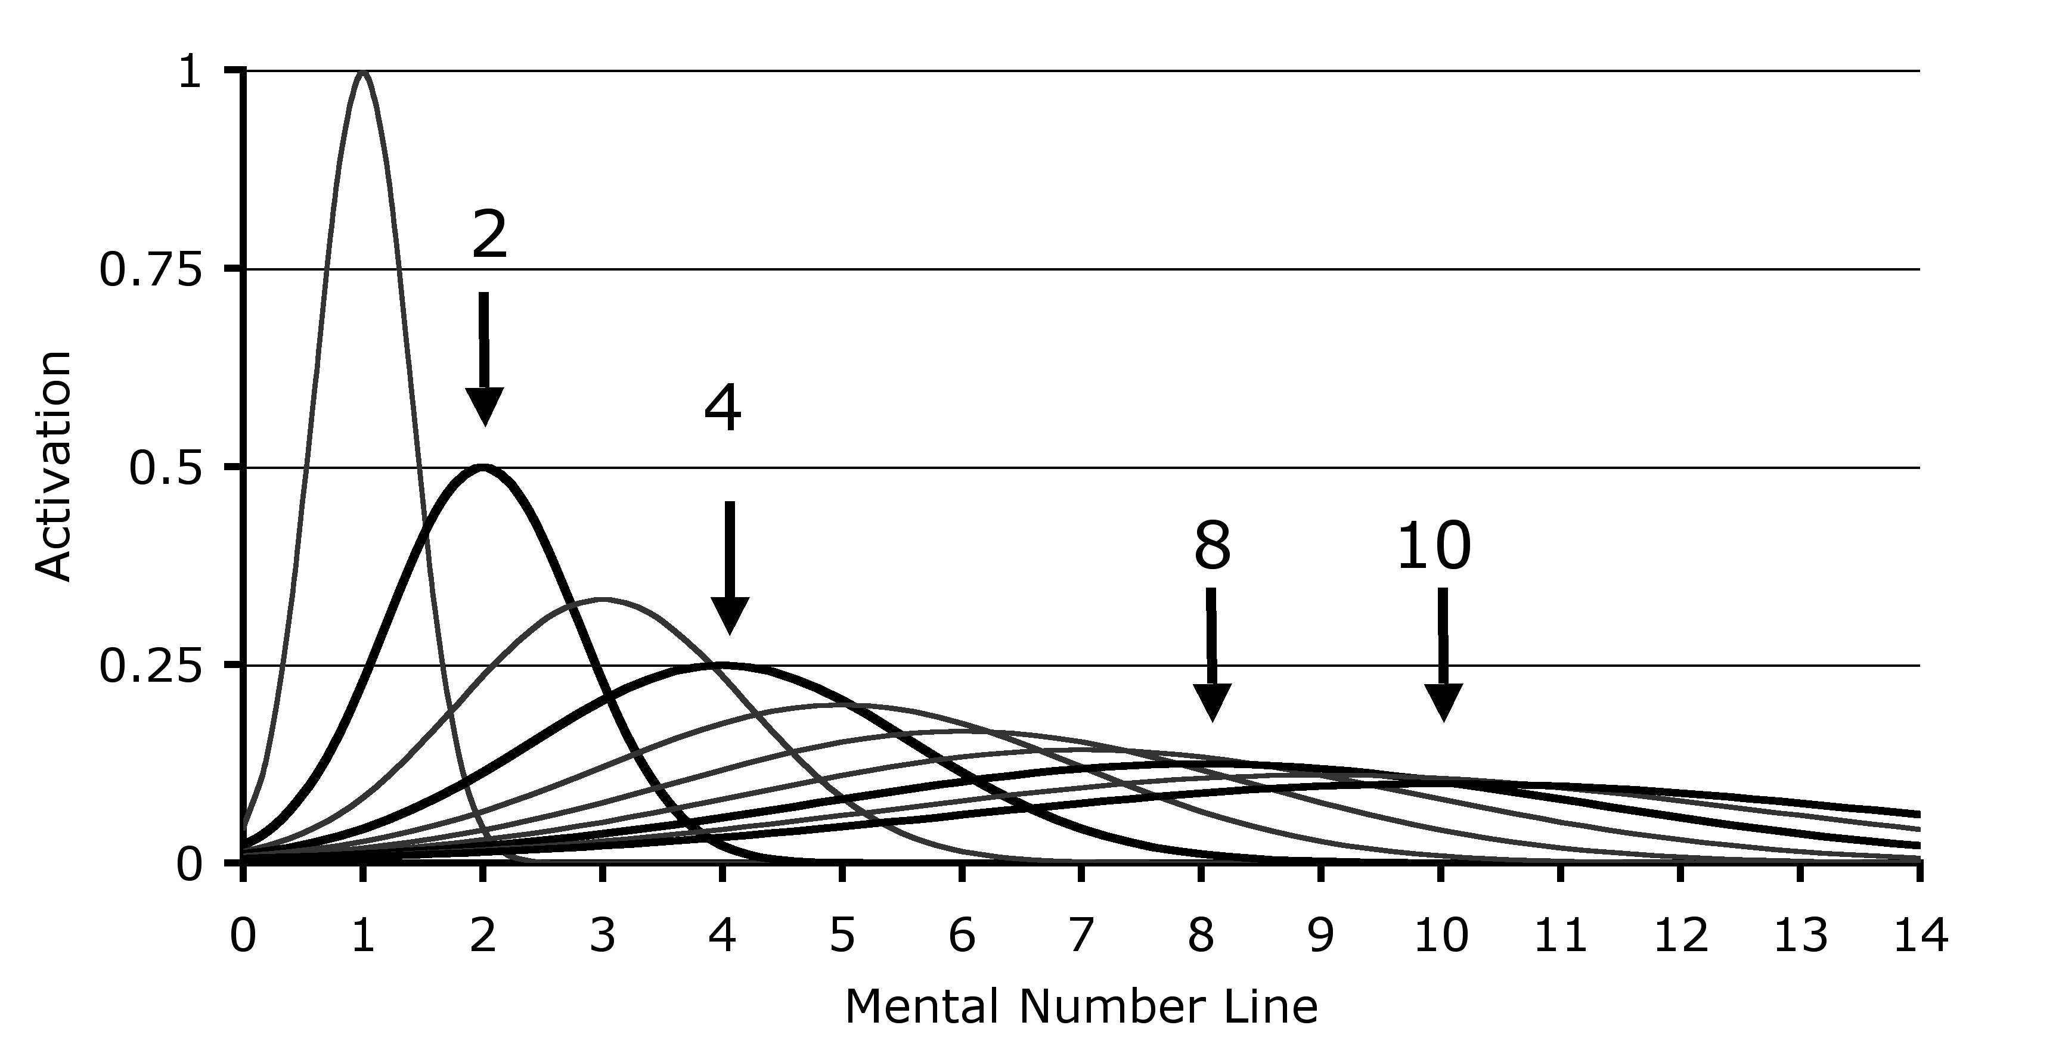
a model of the “Approximate Number System”
(key feature: ratio-dependence of discriminability)
distinguishing 8 dots from 4 (or 16 from 8)
is easier than
distinguishing 10 dots from 8 (or 20 from 10)

Slide 22
a model of the “Approximate Number System”
(key feature: ratio-dependence of discriminability)
correlatively, as the number of dots rises, “acuity” for estimating of cardinality decreases--but still in a ratio-dependent way, with wider “normal spreads” centered on right answers

Slide 23
Most of the dots are yellow?
What conditions
make the
interrogative
easy/hard
to answer?
That might
provide
clues
about
how the
sentence is understood
(given decent accounts of the information available
to human beings in those conditions).
Notes:
1 to 2 SUPER EASY

Slide 24
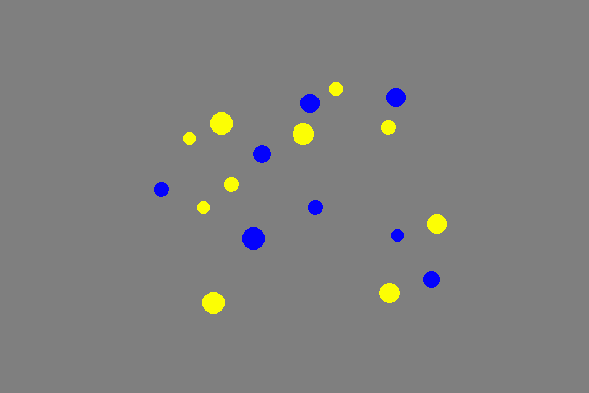
4:5 (blue:yellow)
“scattered pairs”
Notes:
4 to 5

Slide 25
1:2 (blue:yellow)
“scattered pairs”
Notes:
1 to 2 SUPER EASY

Slide 26
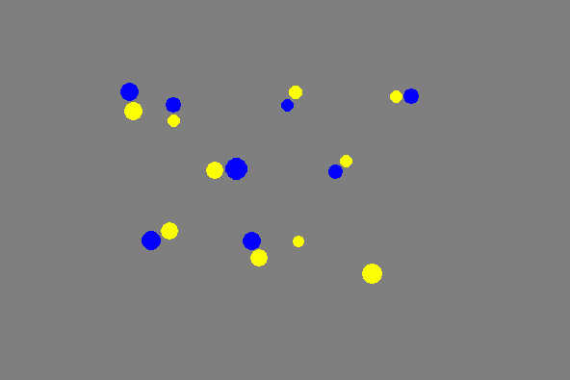
4:5 (blue:yellow)
“scattered pairs”

Slide 27
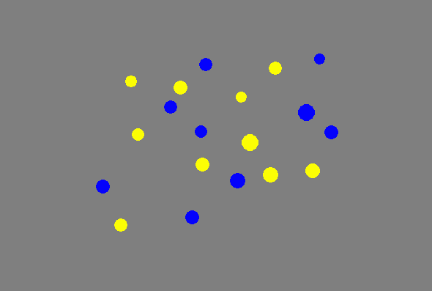
9:10 (blue:yellow)
“scattered pairs”
Notes:
9 tp 10

Slide 28
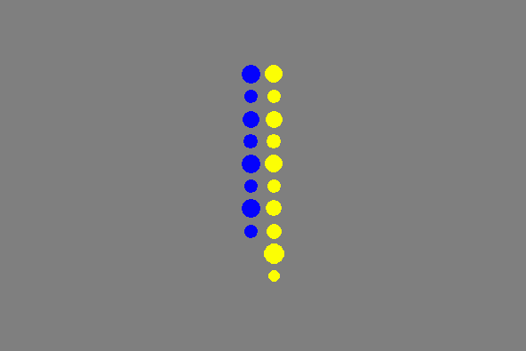
4:5 (blue:yellow)
“column pairs sorted”

Slide 29
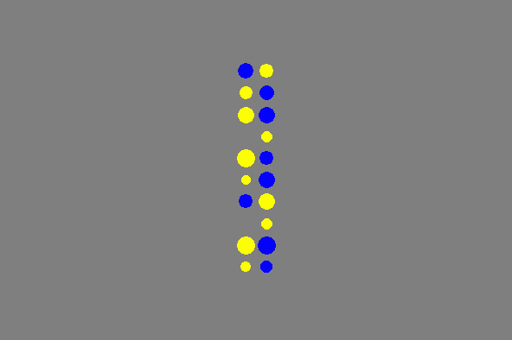
4:5 (blue:yellow)
“column pairs mixed”
Notes:
4 to 5

Slide 30
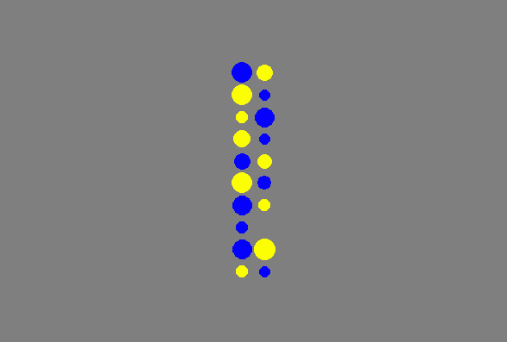
5:4 (blue:yellow)
“column pairs mixed”
Notes:
9 to 10

Slide 31
scattered random
scattered pairs
4:5 (blue:yellow)
column pairs mixed
column pairs sorted

Slide 32
Basic Design
12 naive adults, 360 trials for each participant
5-17 dots of each color on each trial
trials varied by ratio (from 1:2 to 9:10) and type
each “dot scene” displayed for 200ms
target sentence: Are most of the dots yellow?
answer ‘yes’ or ‘no’ by pressing buttons on a keyboard
correct answer randomized
controls for area (pixels) vs. number, etc.

Slide 33
scattered random
scattered pairs
4:5 (blue:yellow)
THIS IS THE ONLY ODDBALL
column pairs mixed
column pairs sorted

Slide 34
better performance on easier ratios: p < .001
10 : 10
10 : 20
10 : 15

Slide 35
performance on Scattered Pairs and Mixed Columns
was no better than on Scattered Random…
looks like ANS was used to answer the question,
except in Sorted Columns

Slide 36
but even better performance on the components of a
1-to-1-plus task if the question is not posed with ‘most’
10 : 10
10 : 20
10 : 15

Slide 37
scattered random
scattered pairs
4:5 (blue:yellow)
column pairs mixed
column pairs sorted

Slide 38
‘Most of the dots are yellow’
MOST[D, Y]
OneToOnePlus[{D & Y},{D & ∼Y}]
#{D & Y} > #{D & ∼Y}
#{D & Y} > #{D} – #{D & Y}
Prima facie,
posing the question with ‘most’
is not a way
of posing a OneToOnePlus question

Slide 39
‘Most of the dots are yellow’
MOST[D, Y]
#{D & Y} > #{D & ∼Y}
#{D & Y} > #{D} – #{D & Y}
framing the question
with ‘most’
has effects that are
expected if the question
is understood in terms of
cardinality comparison
(and answered via the ANS)

Slide 40
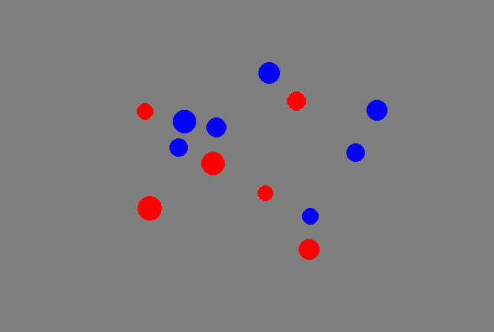
Most of the dots are blue?
What conditions
make the
interrogative
easy/hard
to answer?
That might
provide
clues
about
how the
sentence is understood
(given decent accounts of the information available
to human beings in those conditions).

Slide 41
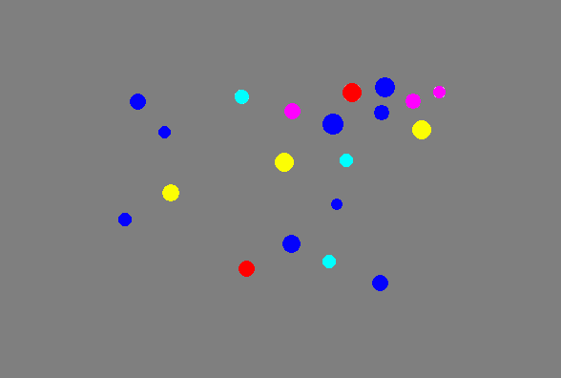
Most of the dots are blue?

Slide 43
‘Most of the dots are blue’
#{Dot & Blue} > #{Dot & ~Blue}
in scenes with two colors, blue and red,
the non-blues can be identified with the reds
#{Dot & ~Blue} = #{Dot & Red}
the visual system will “select” the dots, the blue dots, and
the red dots; these 3 sets will be estimated for cardinality
but adding colors will make it harder (and with 5 colors,
impossible) to obtain a cardinality estimate for each color
#{Dot & Blue} > #{Dot} − #{Dot & Blue}

Slide 44
‘Most of the dots are blue’
#{Dot & Blue} > #{Dot & ~Blue}
verification should get harder
as the number of colors increases
“acuity” should be relatively good (w ≈ .15)
#{Dot & Blue} > #{Dot} − #{Dot & Blue}
predicts indifference to the number of alternative colors
“acuity” should be less good (w ≈ .3)
15 dots, 9 blue
9 > 6
15 dots, 9 blue
15 > (15 − 9)

Slide 45
#{Dot & Blue} >
#{Dot & ~Blue}
#{Dot & Blue} >
#{Dot} − #{Dot & Blue}
6
9
15

Slide 46
‘Most of the dots are blue’
#{Dot & Blue} > #{Dot & ~Blue}
verification should get harder
as the number of colors increases
“acuity” should be relatively good (w ≈ .15)
#{Dot & Blue} > #{Dot} − #{Dot & Blue}
predicts indifference to the number of alternative colors
“acuity” should be less good (w ≈ .3)
15 dots, 9 blue
9 > 6
15 dots, 9 blue
15 > (15 − 9)

Slide 47
better performance on easier ratios: p < .001

Slide 48
no effect of number of colors

Slide 49
fit to psychophysical model of ANS-driven performance

Slide 51
‘Most of the dots are blue’
MOST[D, B]
#{D & B} > #{D & ∼B}
#{D & B} > #{D} – #{D & B}
Prima facie,
posing the question with ‘most’
is not a way
of posing a
cardinality
question
formulated in
terms of negation

Slide 52
‘Most of the dots are blue’
MOST[D, B]
#{D & B} > #{D} – #{D & B}
framing the question
with ‘most’
has effects that are
expected if the question
is understood in terms of
cardinality subtraction
??Most of the paint is blue??

Slide 53
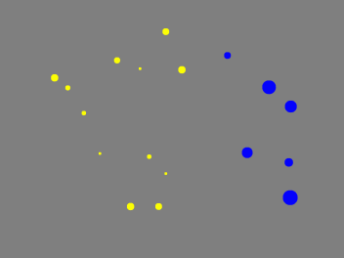

Slide 54
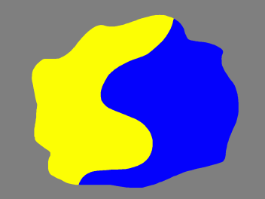

Slide 55
‘Most of the dots are blue’
#{Dot & Blue} > #{Dot} − #{Dot & Blue}
mass/count flexibility
Most of the dots (blobs, peas, shoes) are blue
Most of the paint (blob, corn, footwear) is blue
are mass nouns (somehow) disguised count nouns?
#{GooUnit & BlueUnit} >
#{GooUnit} − #{GooUnit & BlueUnit}

Slide 56
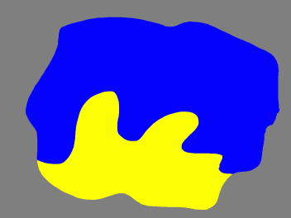
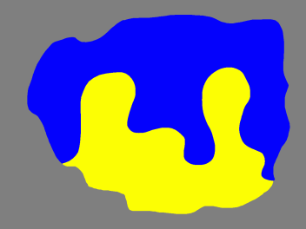
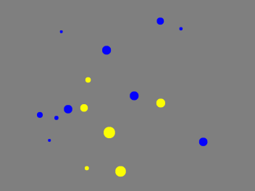
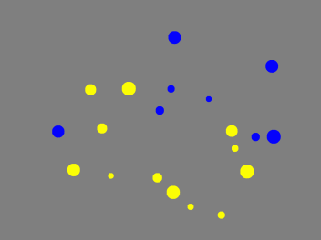

Slide 58
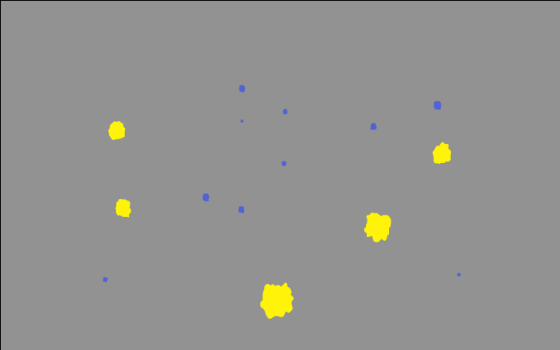

Slide 59
First Study (blob/blobs…others in the works)
Performance is better, holding the scene constant,
if the question is posed with a mass noun
w = .20
r² = .99
w = .29
r² = .98

Slide 60
‘Most of the dots are blue’
#{Dot & Blue} > #{Dot} − #{Dot & Blue}
mass/count flexibility
Most of the dots (blobs, peas, shoes) are blue
Most of the paint (blob, corn, footwear) is blue
are mass nouns (somehow) disguised count nouns?
#{GooUnit & BlueUnit} >
#{GooUnit} − #{GooUnit & BlueUnit}
SEEMS NOT

Slide 61
Most of the dots are blue?
MOST[D, B]
#{D & B} > #{D} – #{D & B}
framing the question
with ‘most’
has effects that are
expected if the question
is understood in terms of
cardinality subtraction
Prima facie, this requires
a representation of #{D}
and a computation on
this representation.
Does use of ‘most’ reflect
ease/difficulty of representing #{D}?

Slide 62
left
right
% Of Undergrads Who
Choose This Side (N= 48)
Asked, “Most” = 58%
Asked, “More” = 13%
Notes:
G1: most of the dots are blue
Back
G2: there are more blue dots than yellow dots
2nd time: click for data

Slide 63
Which sentence would you choose to describe this picture?
A) More of the dots are grey.
B) Most of the dots are grey.
65% choose “more”

Slide 64
Which sentence would you choose to describe this picture?
A) More of the dots are grey.
74% choose “most”
B) Most of the dots are grey.

Slide 65
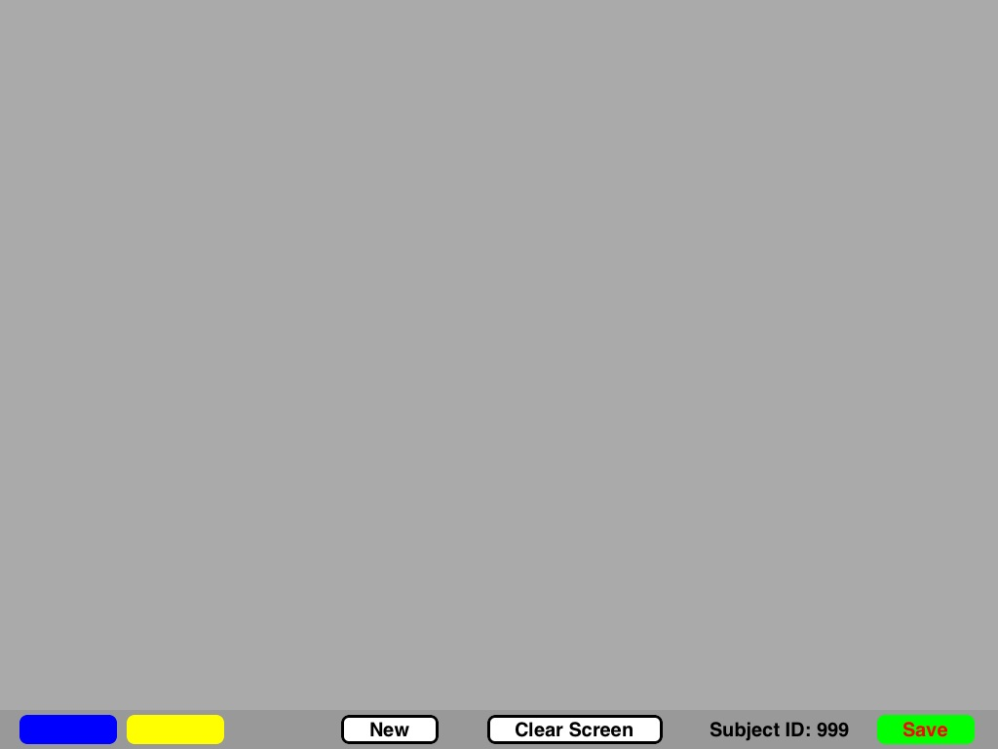
Not just about recognition
80 participants asked to “draw” on an iPad More/Most of the dots are blue

Slide 66
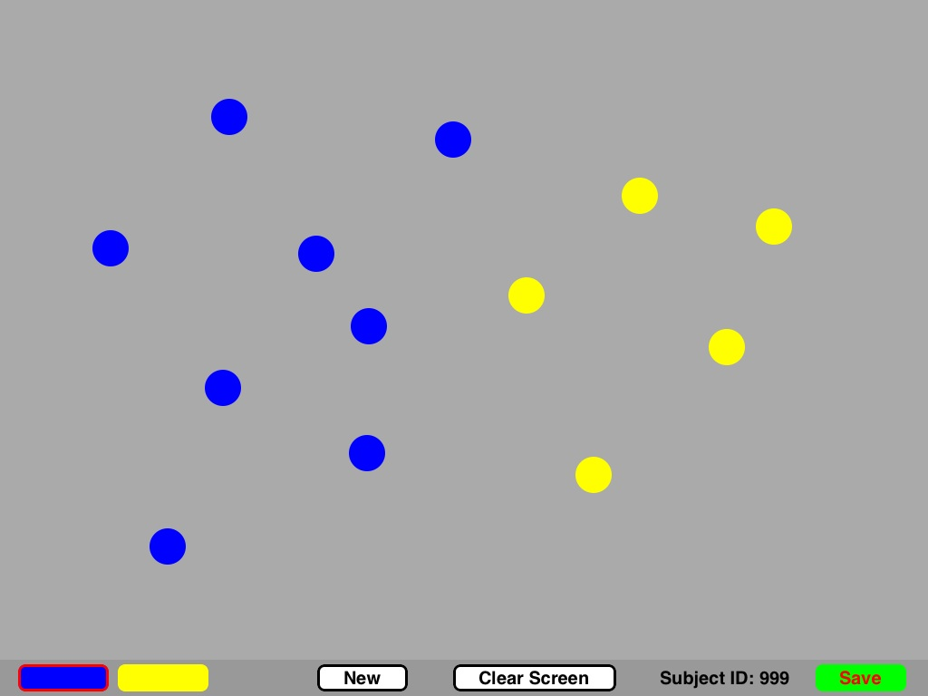
Not just about recognition
Typical for “More of the dots are blue”

Slide 67
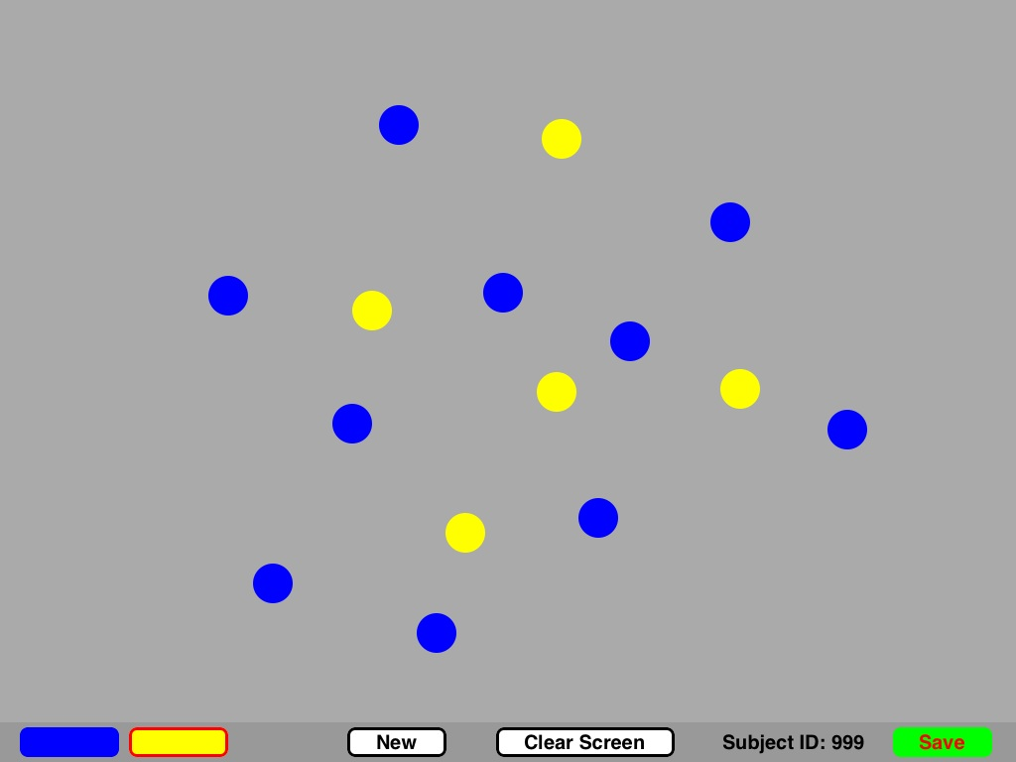
Not just about recognition
Typical for “Most of the dots are blue”

Slide 68
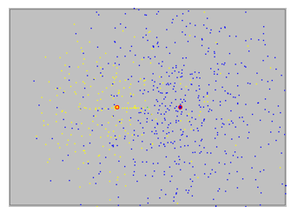
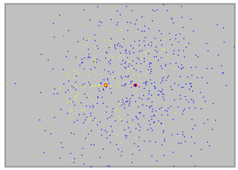
Centroid distance (adults)
More Most
  Halberda, Pietroski, Hunter, Odic, Wellwood, & Lidz. (2012). More & most: spatial vision affects word understanding on an iPad. Vision Science Society annual meeting.

Slide 69
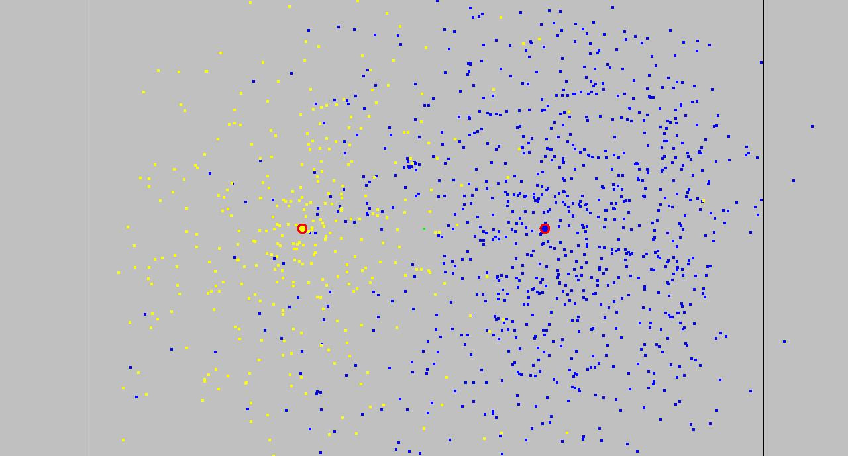
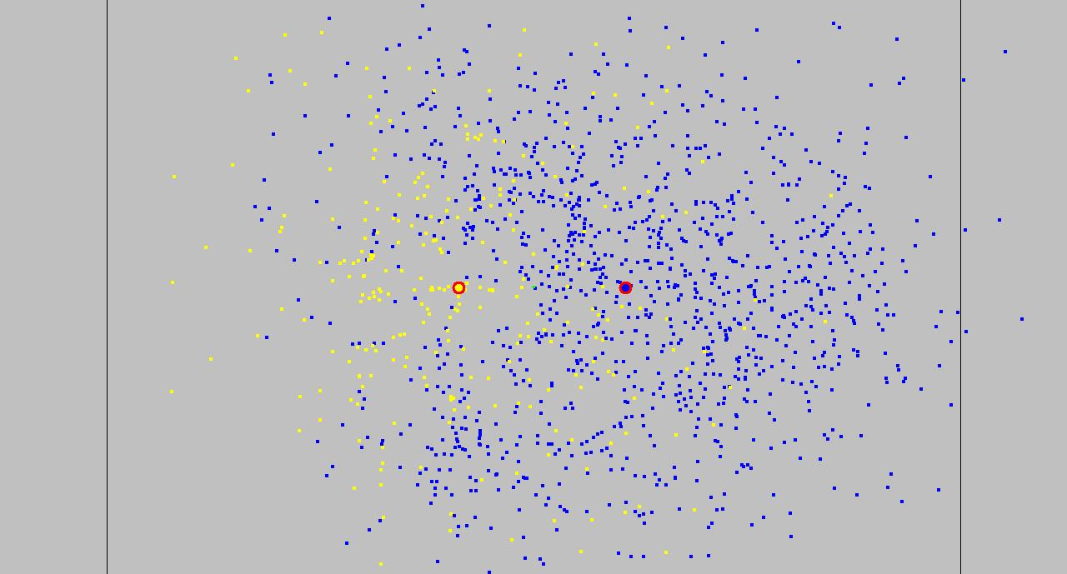
4-8 yr olds (n=92)
More
Most

Slide 70
Future Directions
While successes at 200ms can be illuminating, our claim is not that 200ms is the “understanding window.” But given the information available, different claims about how sentences are understood may lead to different predictions about how well competent speakers can evaluate the sentences.
Failures with no time constraints can also be illuminating
(recall the Schelling puzzle about tax deductions)
If people have the information needed to answer question Q,
but they don’t settle on judgments about a target sentence,
then maybe the target sentence does not pose question Q.

Slide 71
The red circles are bigger than the other circles
The red circles are the biggest
The biggest circles are red
(pilot data: 100% yes)
Notes:
Alexis 9, shuffled as 14
NO-BRAINER “YES”

Slide 72
The red circles are bigger than the other circles
The red circles are the biggest
The biggest circles are red
(pilot data: 85% yes)
Notes:
ALEXIS 10, shuffled as 15 SHOULD STILL BE NO-BRAINER “YES”...THE SMALL RED ONE SHOULD NOT MATTER...
YET…about a 15% hit on answering YES

Slide 73
Could it be that mixing plurality and comparison
doesn’t determine a clear truth condition?
The red circles are bigger than the other circles
The red circles are the biggest
The biggest circles are red
(pilot data: about 50% yes…doesn’t look like 2 subgroups)
what are the meanings such that
the sentences and the scene don’t determine the answers?
Notes:
ALEXIS 11, shuffled as 16
people at about 50/50 here, with no sign of 2 subpopulations…suggesting indeterminacy…but ER is better than EST
COMPARE: “THERE ARE SOME REDS SUCH THAT EACH OF THEM IS BIGGER THAN THE OTHER CIRCLES,” WHICH IS CLEARLY FALSE

Slide 74
The red lines are longer than the other lines
(pilot data: 100% say yes)
Notes:
Alexis 23: ceiling performance, cp. 24

Slide 75
The red lines are longer than the other lines
(pilot data: 60% say yes)
Notes:
Alexis 24
here one blue mixed in sends yeses to 60%

Slide 76
The red lines are longer than the blue lines
(pilot data: about 0% say yes)
Notes:
Alexis 8: 0%

Slide 77
The red lines are longer than the blue lines (pilot data: 30% say yes)
Notes:
Alexis 6
framed this way, more YES (about 30%)

Slide 78
The red lines are longer than the other lines
(pilot data: 95% say yes)
Notes:
ALEXIS 19: RELATIVELY CLEAR YES…around 95%...though stepped for EST-o and EST-s
though less stepped when the slowpokes are not excluded

Slide 79
The red lines are longer than the other lines
(pilot data: about 50% say yes)
Notes:
Alexis 20: Big framing effect compared to 19, people around 50/50
though least effect with EST-o

Slide 80
The red lines are longer than the other lines
(pilot data: 25% say yes)
Notes:
Alexis 21: still 25% saying YES (stepping down for the other conditions)

Slide 81
potential puzzles for any theory according to which
the sentences have compositionally determined representation-neutral conditions
The red lines are longer than the other lines
(pilot data: 0% say yes)
Notes:
Alexis 22: here the reframe (of 21) sends ER to 0
smaller effect for EST-o, none for est-s

Slide 82
Mostly Framing
Paul M. Pietroski
University of Maryland
Dept. of Linguistics, Dept. of Philosophy

Slide 83
Torcello was moved to Venice.
Venice is a nice place.
Venice may need to be moved.
Torcello was moved to a nice place
that may need to be moved.

