Slide 1
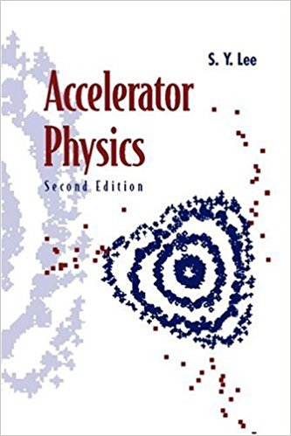

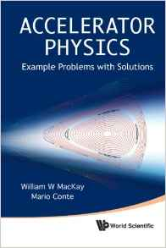
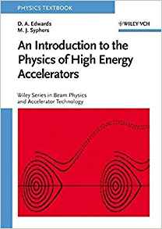


BETATRON RESONANCES
Santiago Bernal
EE686 University of Maryland, College Park, MD
April 4th, 2017
IREAP

Slide 2
REFERENCES
Edwards-Syphers, An Introduction to the Physics of High Energy Accelerators, Wiley-VCH, 2004
Klaus Wille, The Physics of Particle Accelerators, an introduction, Oxford 2000
Henri Bruck, Circular Particle Accelerators, LA-TR-72-10 Rev., Los Alamos, 1972 (available online)
S. Y. Lee, Accelerator Physics, Second Edition, World Scientific, 2004
MacKay-Conte, Accelerator Physics, Example Problems with Solutions, World Scientific, 2012
Bryant-Johnsen, The Principles of Circular Accelerators and Storage Rings, Cambridge U. Press, 1993
Wiedemann, Particle Accelerator Physics, Third Edition, Springer, 2007
Santiago Bernal, A Practical Introduction to Beam Physics and Particle Accelerators, IOP, Morgan & Claypool Pub., 2016
Martin Reiser, Theory and Design of Charged Particle Beams, 2nd Ed., Wiley-VCH, 2008
USPAS and CERN class notes
G. Guignard, A General Treatment of Resonances in Accelerators, CERN, 1978; K. Symon, Applied Hamiltonian Dynamics, in AIP Conf. Proc. 249, Vol.1, 1989-90

Slide 3
OUTLINE
(Slides and other material in http://ireap.umd.edu/faculty/bernal)
Example of nonlinear dynamics
HiLL’S EQUATION AND FLOQUET’s transformation
1-D short derivation OF RESONANCE CONDITIONs
LINEAR RESONANCES AGAIN
  Integer
  Half-integer
Linear coupling
NONLINEAR RESONANCES
  Third-Integer
  General
General RESONANCE CONDITION and TUNE DIAGRAM

Slide 4
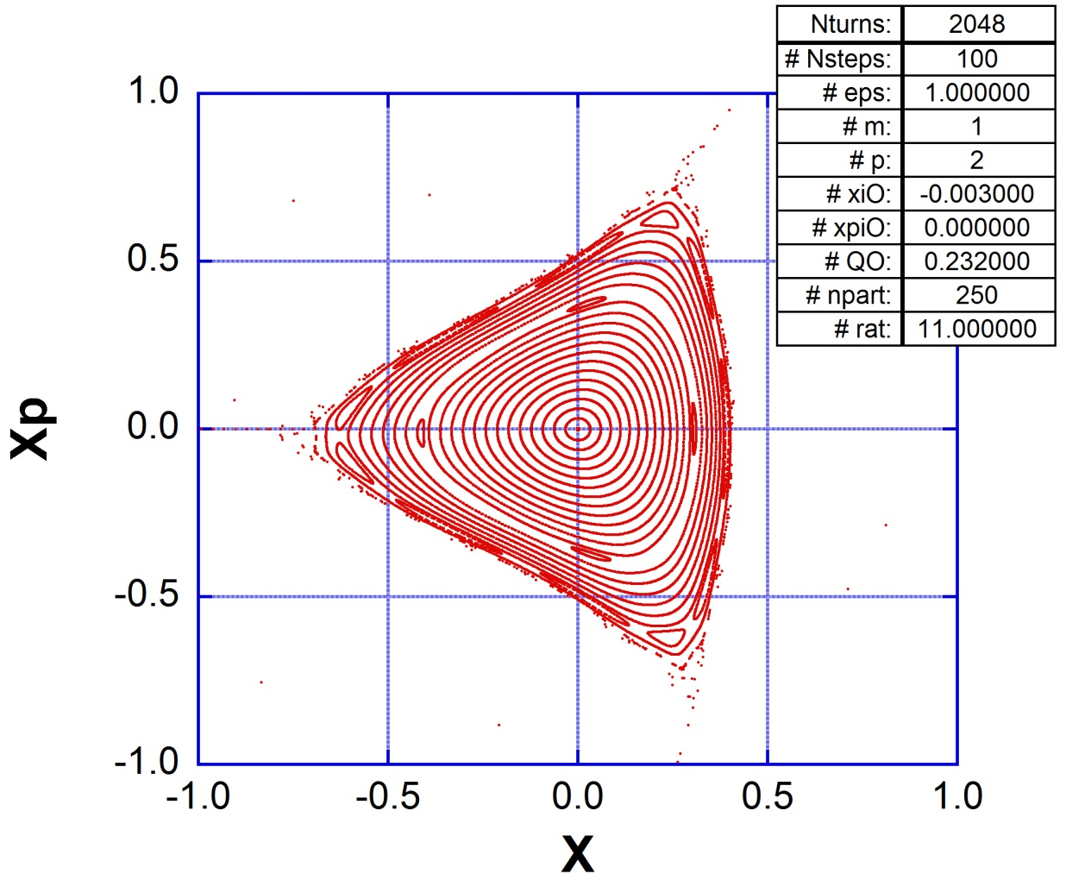
EXAMPLE OF NONLINEAR DYNAMICS
(MacKay-Conte, Accelerator Physics, Example Problems with Solutions, 10.2.3)
Thanks to Levon
for help with
debugging and
compiling C code

Slide 5
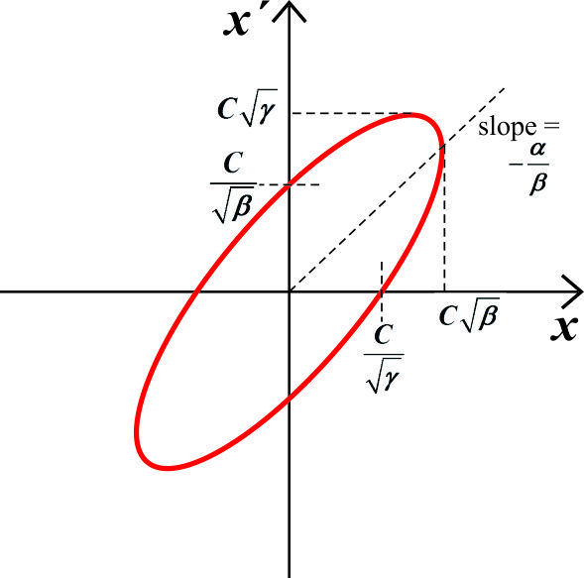
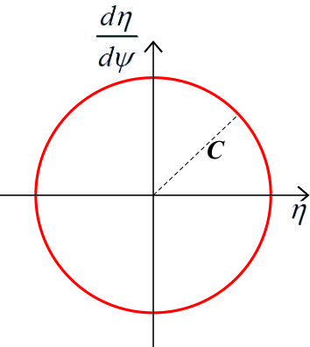
HiLL’S EQUATION AND FLOQUET’s transformation
(See Reiser, Sec. 3.8.2, Bernal, Sec. 3.3)
Hill’s Equation:
and similarly for ‘y’.
Courant-Snyder Coeff.
C-S Invariant
Floquet’s Transformation:
Betatron Tune

Slide 6
1-D, Short derivation of resonance conditions
(See Wille, Sec. 3.14.3; Edwards-Syphers, Sec. 4.1; Bernal, Sec. 6.2)
With field errors,
Magnetic rigidity
Dipole error
Quadr. error
Sextupole error
Linear
res.
Integer resonance,
Half-integer resonance,
Third-integer resonance.

Slide 7
INTEGER RESONANCE AGAIN
(See Henri Bruck, Circular Particle Accelerators LA-TR-72-10 Rev., or Reiser, Sec. 3.8.6)
Driven S.H.O.:
k: integer
Solution:
Amplitude  
(Alternative treatment in Bernal, Sec. 6.2)

Slide 8
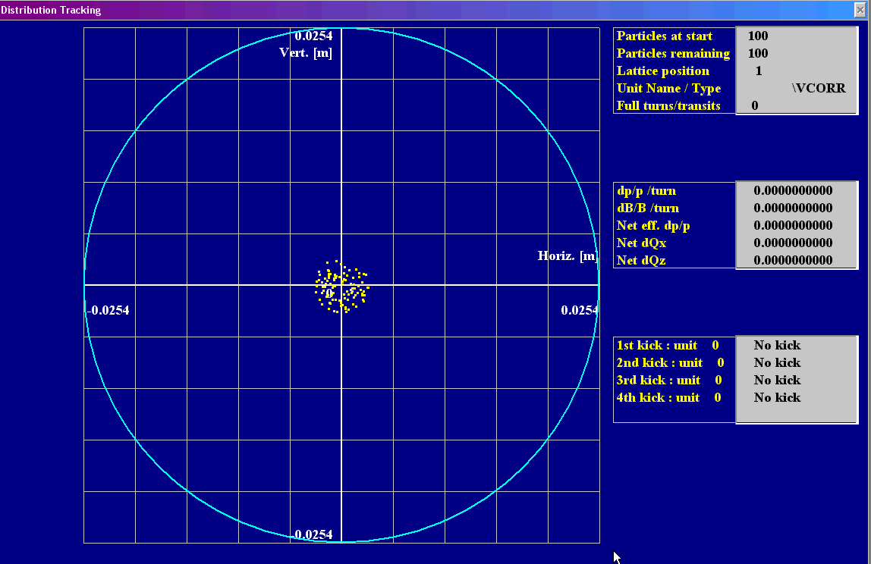
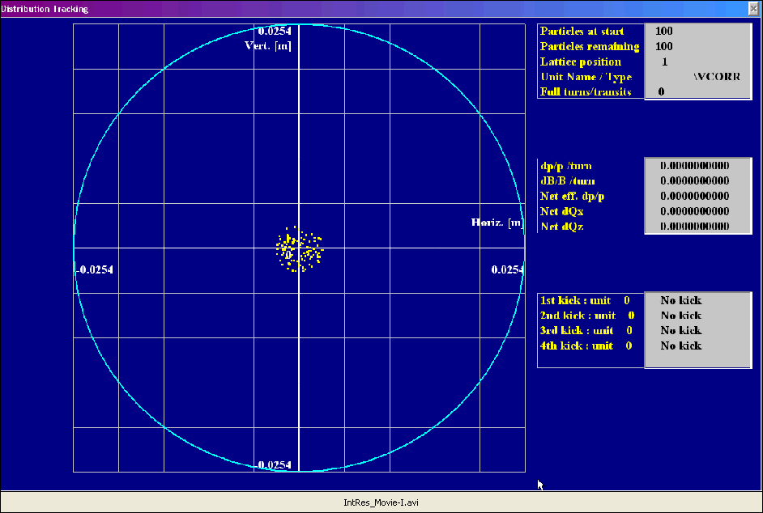
INTEGER RESONANCE: WINAGILE SIMULATION

Slide 9
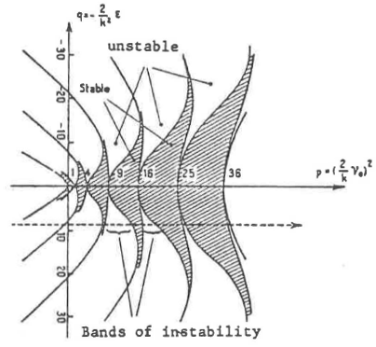
HALF-INTEGER RESONANCE AGAIN
(See Henri Bruck, Circular Particle Accelerators LA-TR-72-10 Rev., or Reiser, Sec. 3.8.6)
Linear term on RHS,
k= integer.
Convert equation to
a Mathiew equation,
by using:
Mathiew equation is a S.H.O equation if
Points m = 1,2,3,… along p axis (next slide) correspond to unstable solutions of Mathiew equation. Therefore, resonance condition is:

Slide 10
BANDS OF STABILITY OF MATHIEU EQUATION
(See Henri Bruck, Circular Particle Accelerators LA-TR-72-10 Rev., or Reiser, Sec. 3.8.6)

Slide 11
LINEAR COUPLING
(See Henri Bruck, Circular Particle Accelerators LA-TR-72-10 Rev)
Linear coupling between transverse degrees of freedom:
Consider the second equation: equate RHS and LHS frequencies to find resonance conditions:
Sum resonance, unstable
Difference resonance, stable

Slide 12
NONLINEAR RESONANCES
(See Henri Bruck, Circular Particle Accelerators LA-TR-72-10 Rev.)
Quadratic term on rhs,
k= integer.
Resonance conditions:
Third-integer res.
In General,
l >1: integer.
Resonance conditions:

Slide 13
THIRD-INTEGER RESONANCE AGAIN
(See S. Y. Lee, Accelerator Physics, Ch. 2, Sec. VII; Edwards-Syphers, Ch. 4)
Hill’s Equations with
sextupole field:
Betatron Hamiltonian:
Action-Angle
form of V₃:
Sextupole resonances to first order order
Resonance | Driving Term | Classification
 |  | Sum Resonance
 |  | Difference Res.
 |  | Parametric Res.
 |  | Parametric Res.

Slide 14
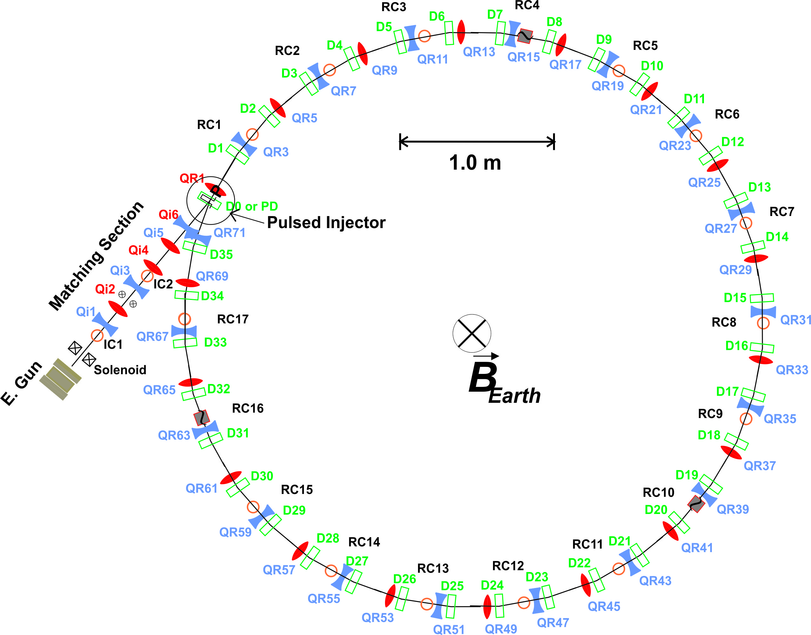
GENERAL RESONANCE CONDITION
Betatron Tunes:
Resonance Condition:
n, m, N, p: integers
|n| + |m| = order of resonance, N: lattice super-periodicity
Examples:
UMER
NSLS VUV
at BNL
N = 18, ideally;
N=1 in practice
N = 4

Slide 15
TUNE DIAGRAM TO THIRD ORDER
(Wiedemann, Ch. 13, Winagile code, TAPAS)

Slide 16
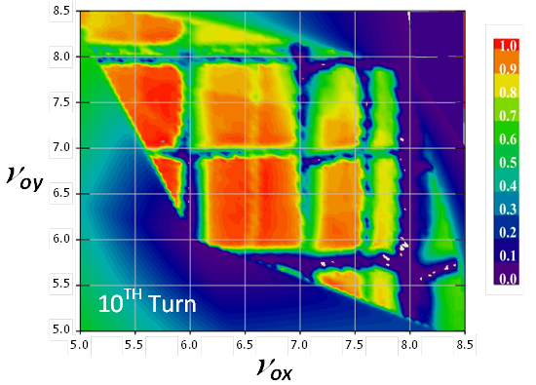
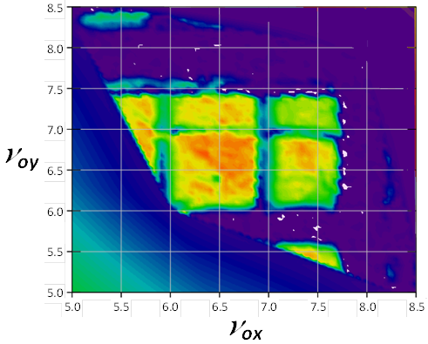
UMER 6 mA BEAM, 10TH-TURN SURVIVAL VS. (ESTIMATED) HOR. & VERT. TUNES
(Ruisard, Beaudoin, Bernal; Bernal, eqs. 3.2.6-7, Fig. 6.9)
02-23-2017
← After machine rebuild, alignment
03-05-2013

Slide 17
APPLICATION OF THIRD-INTEGER RESONANCE: SLOW EXTRACTION
(Edwards-Syphers, Ch. 4)

