Slide 1

Making Waves:
The basic math of sound and music
Tom O’Haver
Professor Emeritus
University of Maryland at College Park

Slide 2
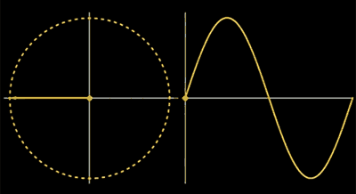

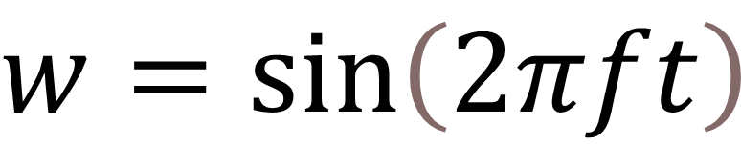
A simple sine wave using the “sine” function, written as “sin”:
$$w=sin\left(2πft\right)$$
where f is frequency and t is time.
Sine waves arise naturally in vibrations and circular motion. (A cosine wave is similar except that it starts at 1 rather than zero)
To create the waveform, w, we code t as a vector.
Here’s what it sounds like at f=880 Hz
Notes:
I will use the simple sine wave as the foundation for developing other waveforms. To convert the math expression into a digitally sampled waveform, we can use a programming language or a spreadsheet. To convert the waveform into a sound, we could use an audio program such as Audacity. Python or Matlab can do the whole job conveniently.

Slide 3
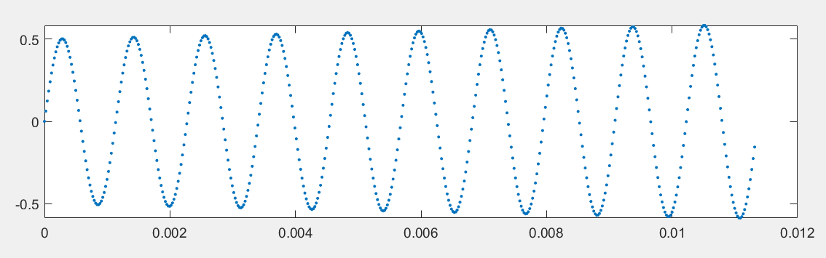
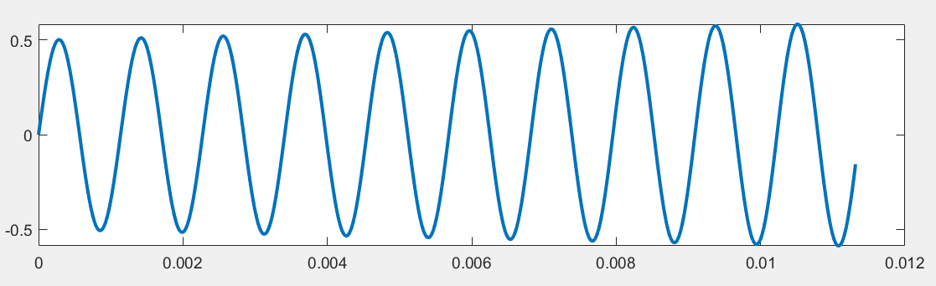
A digitally sampled waveform
As the sampling rate increases, the sampled signal become closer to a continuous analog wave.
The sampling rate must be at least twice the highest frequency in the signal.
Low sampling rate
High sampling rate
Notes:
A common sampling rate for audio signals and music is 44100 Hz (cycles per second).

Slide 4
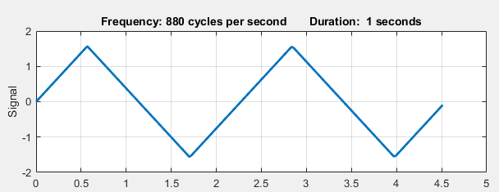
A triangle wave applying the “arcsin” function, written as “asin”:
$$asin(sin\left(2πft)\right)$$

Slide 5
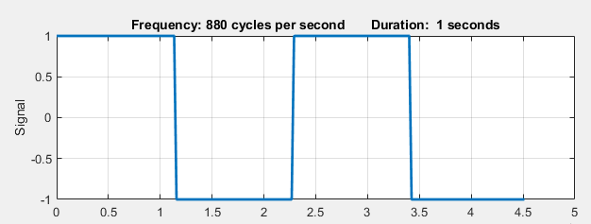
A square wave applying the “sign” function, written as “sgn”:
$$sgn(sin\left(2πft)\right)$$

Slide 6
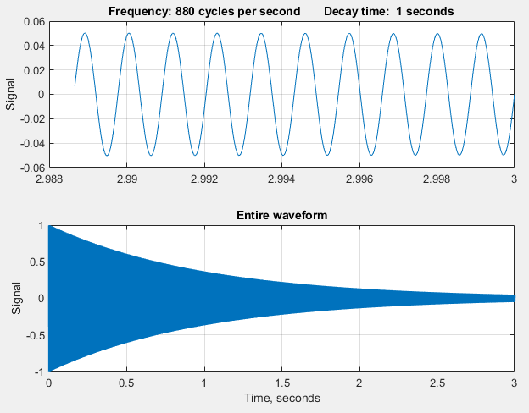

A damped sine wave
$$e^{−t/d}sin\left(2πft\right)$$
where d is the decay time (1 second)
What’s this “e”??
While the base of a common logarithm is 10, the base of a natural logarithm is the special number e. Although this looks like a variable, it represents a fixed irrational number approximately equal to 2.718281828459

Slide 7
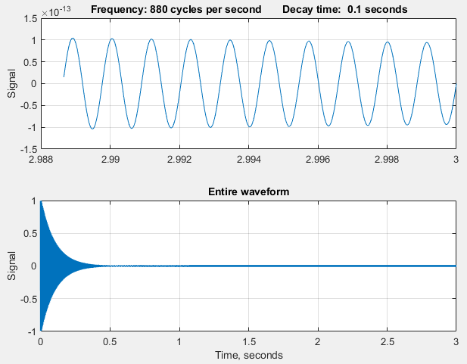

More damped sine wave
$$e^{−t/d}sin\left(2πft\right)$$
With a decay time of 0.1 seconds.

Slide 8
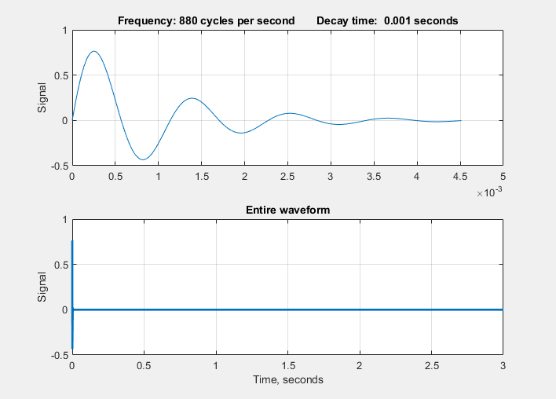

Heavily damped sine wave
$$e^{−t/d}sin\left(2πft\right)$$
with a decay time of 0.001 second.
With such a short decay time, there are too few completed cycles for the ear to latch on to a specific frequency. The effect is more percussive that musical.

Slide 9
Heavily damped sine wave
$$e^{−t/d}sin\left(2πft\right)$$
with a decay time of 0.001 second.
With such a short decay time, there are too few completed cycles for the ear to latch on to a specific frequency. The effect is more percussive that musical.

Slide 10
Heavily damped sine wave
$$e^{−t/d}sin\left(2πft\right)$$
with a decay time of 0.001 second.
With such a short decay time, there are too few completed cycles for the ear to latch on to a specific frequency. The effect is more percussive that musical.

Slide 11
Heavily damped sine wave
$$e^{−t/d}sin\left(2πft\right)$$
with a decay time of 0.001 second.
With such a short decay time, there are too few completed cycles for the ear to latch on to a specific frequency. The effect is more percussive that musical.

Slide 12
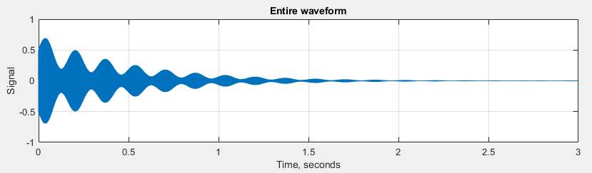
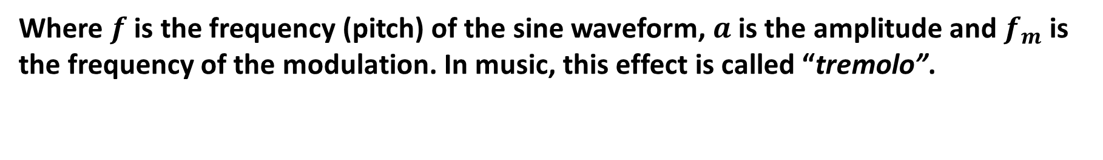

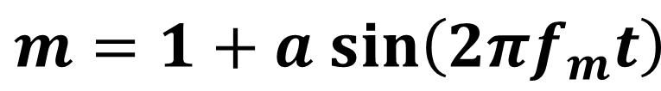
An amplitude-modulated (AM) Sine wave
is obtained by multiplying the sine waveform by a sine wave m of a lower frequency $f_{m}$.
$$m=1+a sin\left(2πf_{m}t\right)$$
$$m sin\left(2πft\right)$$
Where $f$ is the frequency (pitch) of the sine waveform,$a$ is the amplitude and $f_{m}$ is the frequency of the modulation. In music, this effect is called “tremolo”.
As before, the modulation frequency is 5 Hz.
Notes:
For clarity, I will use a two-step procedure,

Slide 13
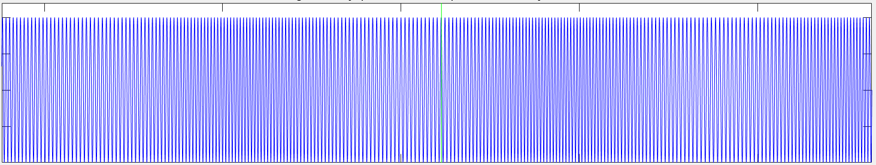
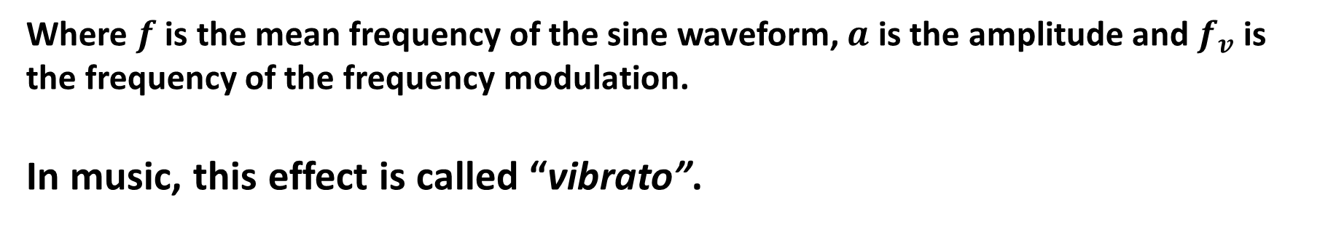

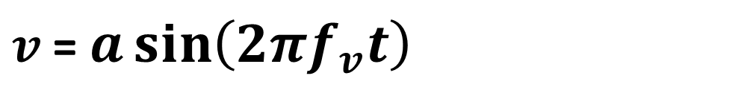
A Frequency-modulated (FM) Sine Wave
is obtained by adding a sine wave $v$ of a lower frequency to the frequency $f$of the waveform.
$v$ = $a\sin\left(2πf_{v}t\right)$
$$\sin\left(2π(f+v)t\right)$$
Where $f$ is the mean frequency of the sine waveform, $a$ is the amplitude and $f_{v}$ is the frequency of the frequency modulation.
In music, this effect is called “vibrato”.
This is easier to see in the waveform plot if viewed from a distance, as a periodic darkening and lightening. The modulation frequency is 5 Hz.

Slide 14
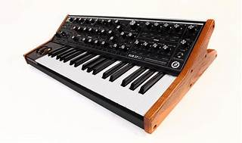
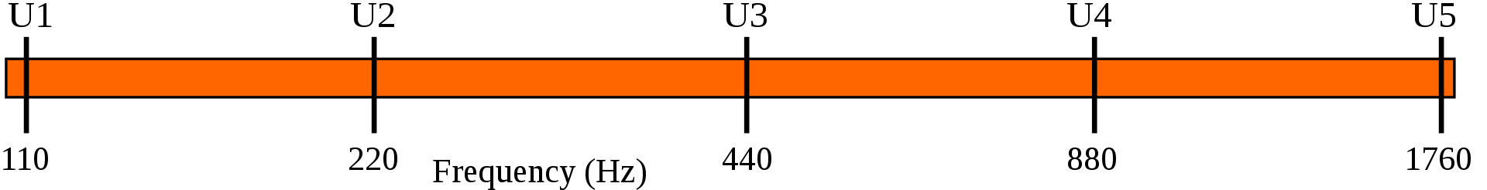
Musical scales
In western music, the frequency of the notes in music are derived
algorithmically.
An “Octave” is defined by a factor of 2 in frequency. Octaves are
equally spaced when measured on a logarithmic scale.
8 octaves of “A”:
3500 to 27 Hz

Slide 15
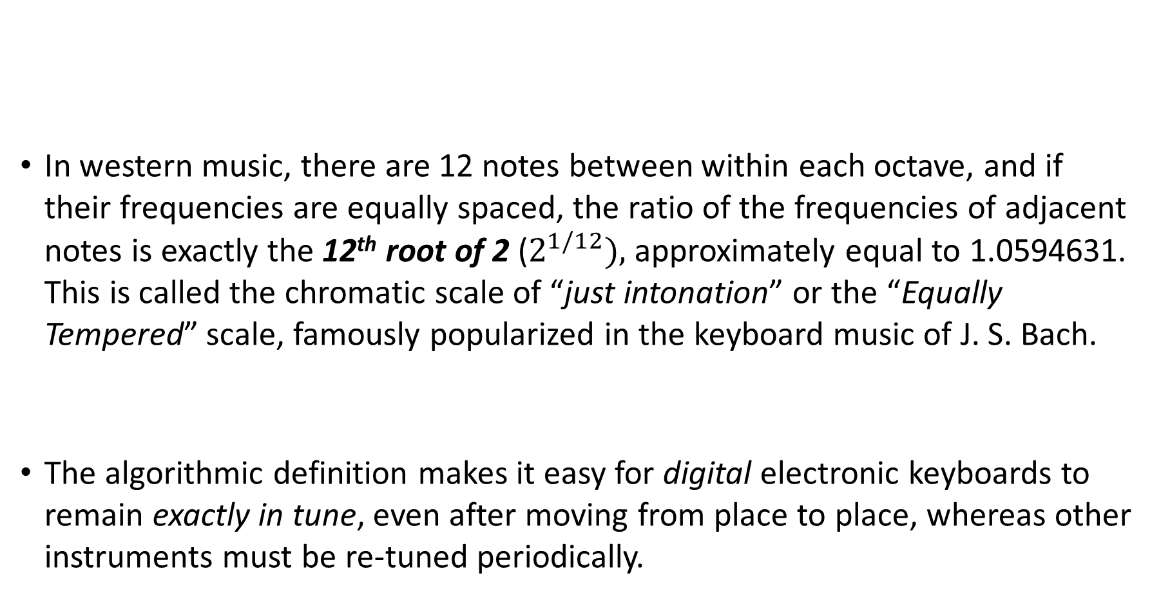
Musical scales
In western music, there are 12 notes between within each octave, and if their frequencies are equally spaced, the ratio of the frequencies of adjacent notes is exactly the 12th root of 2 ($2^{1/12}),$approximately equal to 1.0594631. This is called the chromatic scale of “just intonation” or the “Equally Tempered” scale, famously popularized in the keyboard music of J. S. Bach.
The algorithmic definition makes it easy for digital electronic keyboards to remain exactly in tune, even after moving from place to place, whereas other instruments must be re-tuned periodically.

Slide 16
Harmony
In Western music notes played together sound harmonious when their frequencies are in the ratios of small whole numbers.
If the ratios are not small whole numbers, we hear dissonance.
Perfect fifth 2:3
Major Third 5:4
Minor Third 6:5
Dissonance

Slide 17
Harmony
In Western music notes played together sound harmonious when their frequencies are in the ratios of small whole numbers.
If the ratios are not small whole numbers, we hear dissonance.
Perfect fifth 2:3
Major Third 5:4
Minor Third 6:5
Dissonance

Slide 18
Harmony
In Western music notes played together sound harmonious when their frequencies are in the ratios of small whole numbers.
If the ratios are not small whole numbers, we hear dissonance.
Perfect fifth 2:3
Major Third 5:4
Minor Third 6:5
Dissonance

Slide 19
Harmony
In Western music notes played together sound harmonious when their frequencies are in the ratios of small whole numbers.
If the ratios are not small whole numbers, we hear dissonance.
Perfect fifth 2:3
Major Third 5:4
Minor Third 6:5
Dissonance

Slide 20
Harmony
In Western music notes played together sound harmonious when their frequencies are in the ratios of small whole numbers.
If the ratios are not small whole numbers, we hear dissonance.
Perfect fifth 2:3
Major Third 5:4
Minor Third 6:5
Dissonance

Slide 21
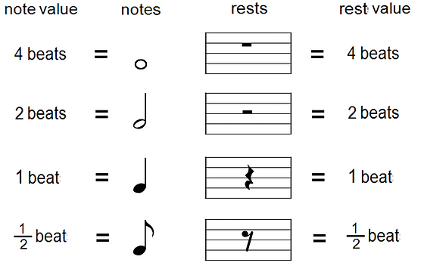
Note values
The duration or length of time a musical note or rest symbol should be held or observed. These are indicated by different symbols in sheet music and most commonly differ by factors or 2.

Slide 22

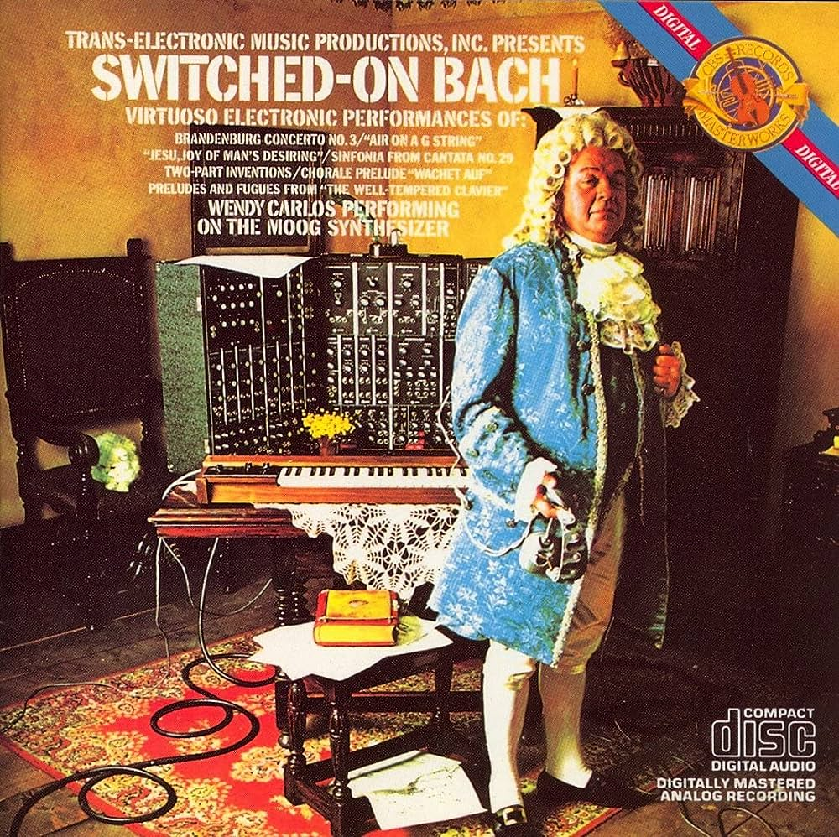
Early examples of electronic music
1956
1968
Notes:
Theremin, an early electronic instrument, was developed in the 1920s in Russia by Leon Theremin.
The Moog synthesizer is a modular synthesizer invented by the American engineer Robert Moog in 1964.

Slide 23
Popular music has relied on synthesizers since the late 1960s and throughout the 1970s.
The Beach Boys - "Good Vibrations" (1966): This iconic song is one of the earliest examples of an electronic sound being used prominently in a pop song.
The Beatles - "Strawberry Fields Forever" (1967): This song features the Mellotron, an early tape-based keyboard instrument that laid the groundwork for modern synthesizers. The Mellotron's flute-like sound is prominently used in the song's intro.
Pink Floyd - "On the Run" (1973): From the album "The Dark Side of the Moon," this instrumental track heavily relies on synthesizers and sequencers to create futuristic and spacey sounds.
Captain & Tennille – “Love Will Keep Us Together” (1975)
Eurythmics/Annie Lennox - “Sweet Dreams (Are Made of This)” (1983)

Slide 24
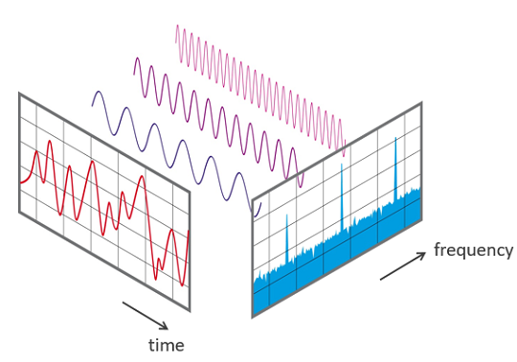
Discrete Fourier Transform F
A Fourier transform is like a mathematical prism that breaks down light onto its component colors, expressing a waveform as a weighted sum of sine and cosine waves. Any discretely sampled signal can be expressed as the weighted sum of a finite number of sine and cosine components whose frequencies are 0, 1 ,2 ,3 ... n/2 times the frequency f=1/d, where d is the duration of the signal.
The Fourier Transform can be evaluated using the “Fast Fourier” (fft) function, which is either built-in (Matlab), imported (Python), or activated (Excel).

Slide 25
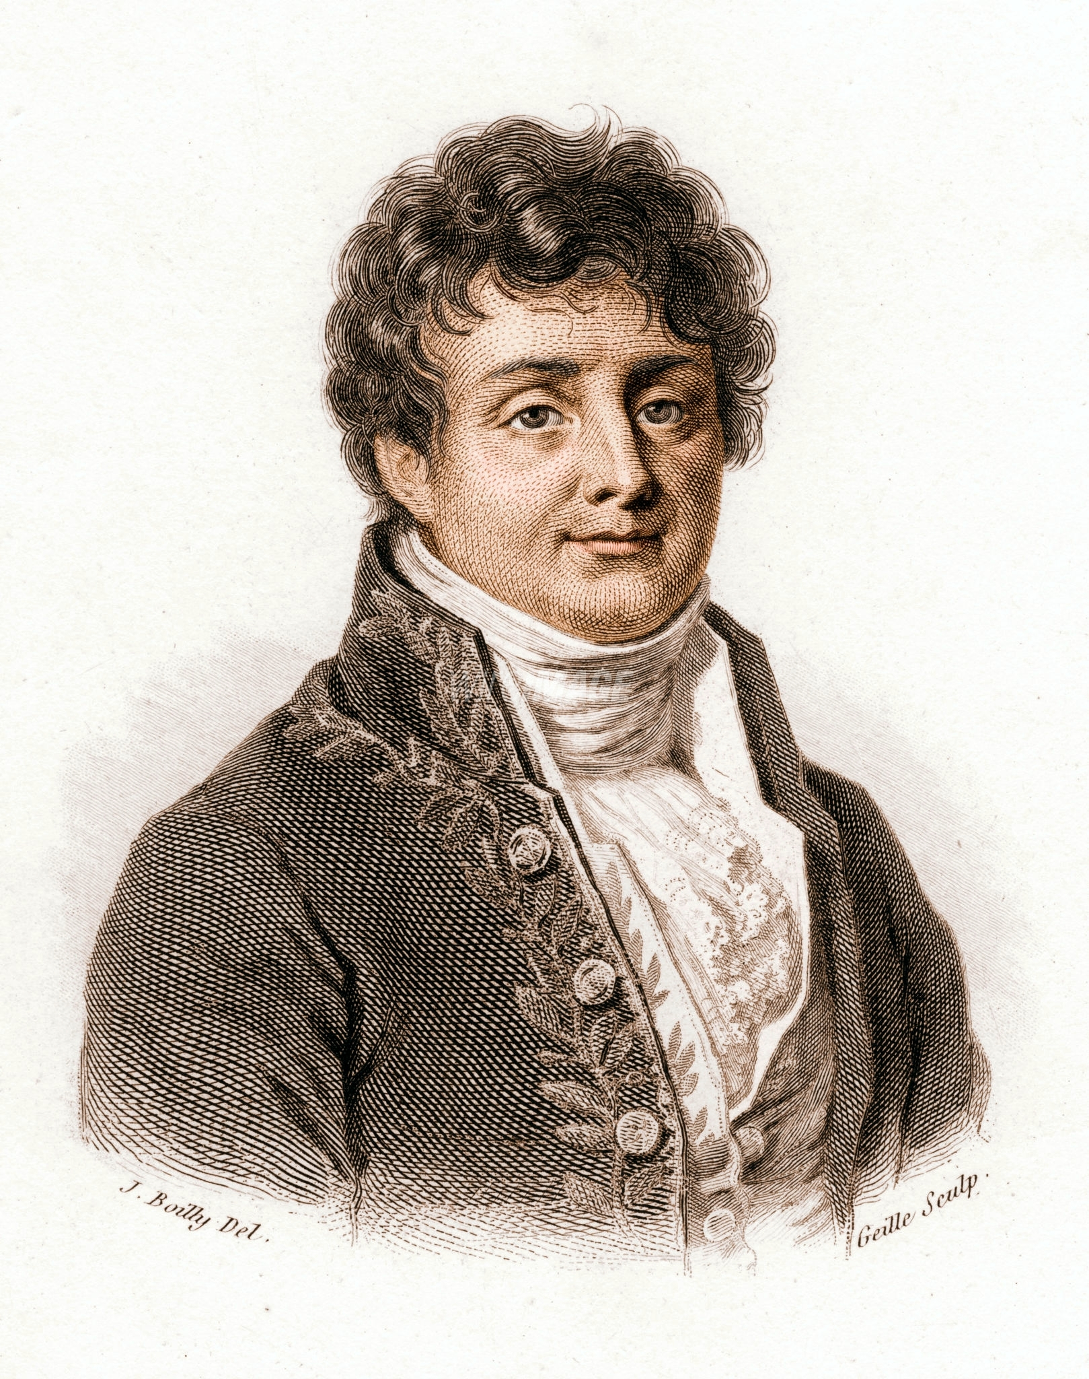
Joseph Fourier
The Fourier Theorem takes its name from the French mathematician Joseph Fourier. He was the son of a tailor, orphaned at age 12, and educated by Benedictine monks. He lived through and survived the French Revolution and eventually accompanied Napoleon Bonaparte on his expedition to Egypt in 1798, where some of Napoleon’s solders uncovered a buried stone slab with an inscription written in three ancient languages, in a little town whose name they mispronounced as “Rosetta”.

Slide 26
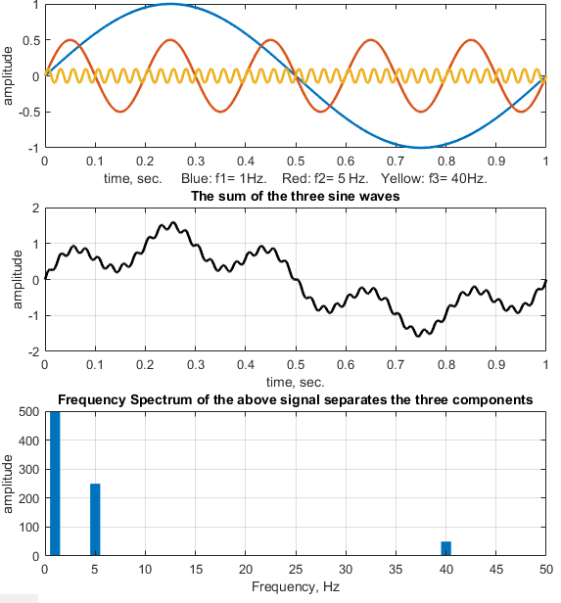
This signal (black) is composed of the sum of three sine wave components, each with a different frequency and amplitude.
The Fourier Transform helps us to understand complex signals:
A simple example
When the frequency spectrum of that signal is computed (using the Fourier Theorem), it shows a peak for each of the components at its correct frequency and amplitude.

Slide 27

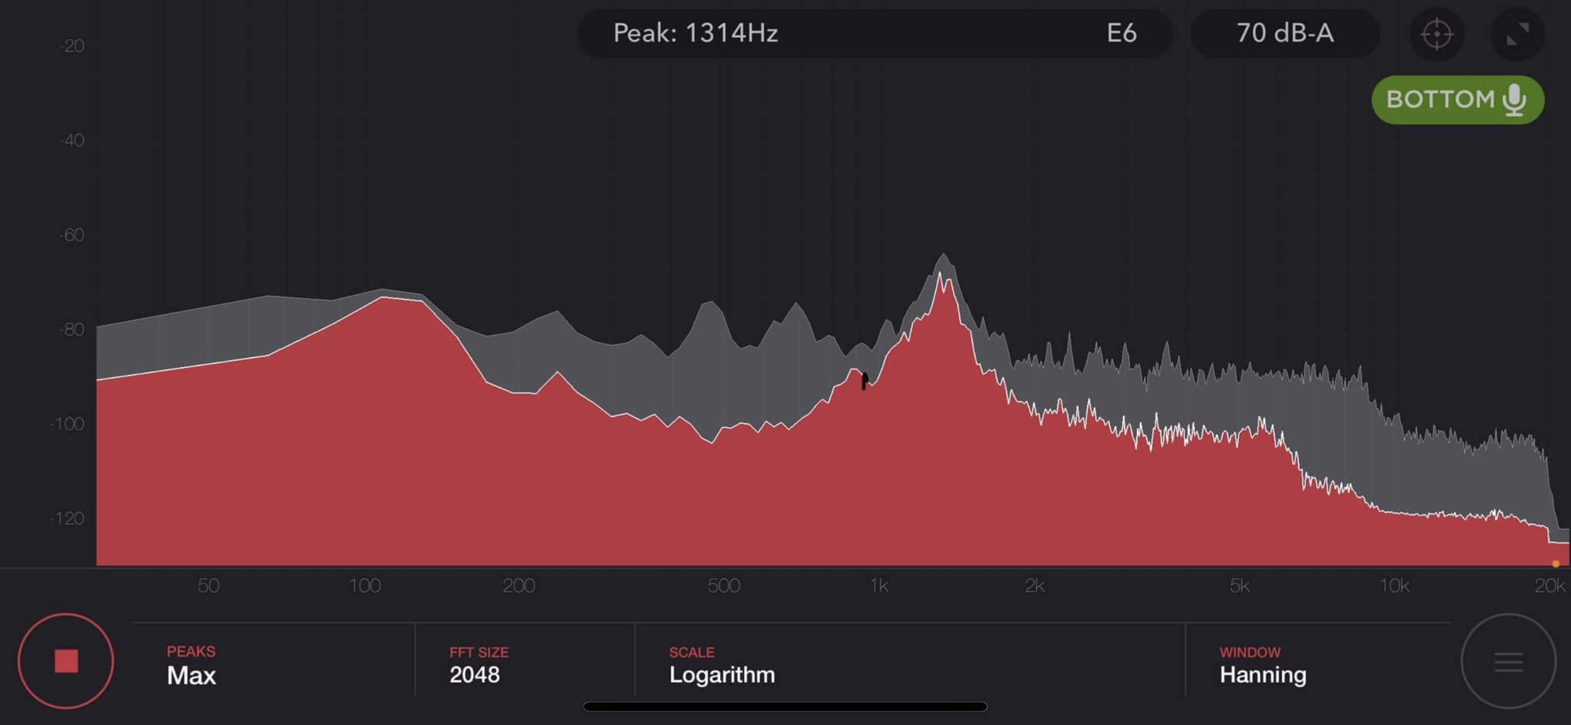
The sound spectrum of the cicadas “singing” in Maryland on May 31, 2021, recorded with the Spectrum app on my phone. The peak occurs at a frequency of ca. 1314 Hz, or musical note E6.
Notes:
During the last cicada outbreak here in Maryland, I recorded the sound spectrum using the “Spectrum” app on my phone

Slide 28
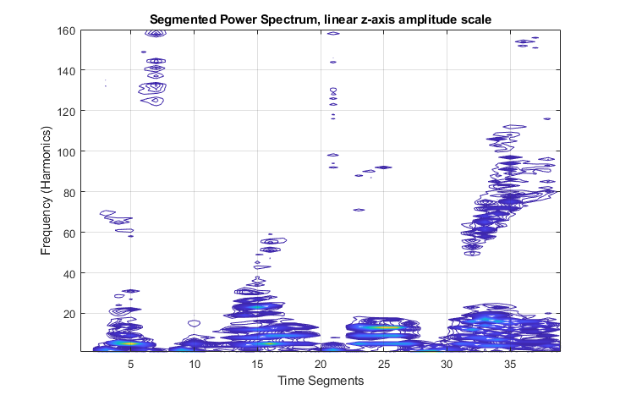
Notes:
The spectrogram is a 2-dimensional time-resolved Fourier spectrum, displayed as a contour plot. Here is the spectrogram of an audio recording of the spoken phrase “Testing, 1,2,3”.

Slide 29
…sting
Th...
T…
Te…
One
…ree.
ooo
Notes:
To make sense of this, I have marked each speech sound. The vowels fall at the lower frequencies (bottom) and the sibilants fall at the higher end (top).

Slide 30
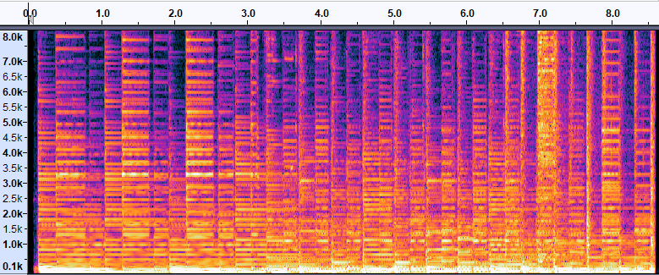
Spectrogram of 8 seconds of music
Frequency →
Time, seconds →
Notes:
The first 8.5 seconds of Paul Simon’s “Kodachrome” (1973). Loudness is in the “z” direction, indicated by lighter colors (yellow and white). There are some guitar chords at 0-3 sec, a 4-note melodic riff at 6 sec in the low-frequency region (100-1000 Hz). At 7-8 seconds, the drummer’s rhythmic high-hat cymbals dominates the high-frequency region. Spectrogram by Audacity.

Slide 31
MP3 compressed file format uses the Fourier Transform
“Psychoacoustic compression”
The Fourier transform is used to analyze the audio signal and identify the frequency components that are less audible to the human ear.
These components can then be simplified without significantly affecting the overall quality of the sound.
This process results in a much smaller file size for the audio.
Storage capacity and data transmission speeds have now increased so much that uncompressed formats are gaining favor. Some people can hear the difference.
WAV format: 1,773 KB

Slide 32
MP3 compressed file format uses the Fourier Transform
“Psychoacoustic compression”
The Fourier transform is used to analyze the audio signal and identify the frequency components that are less audible to the human ear.
These components can then be simplified without significantly affecting the overall quality of the sound.
This process results in a much smaller file size for the audio.
Storage capacity and data transmission speeds have now increased so much that uncompressed formats are gaining favor. Some people can hear the difference.
MP3 format: 233 KB

Slide 33
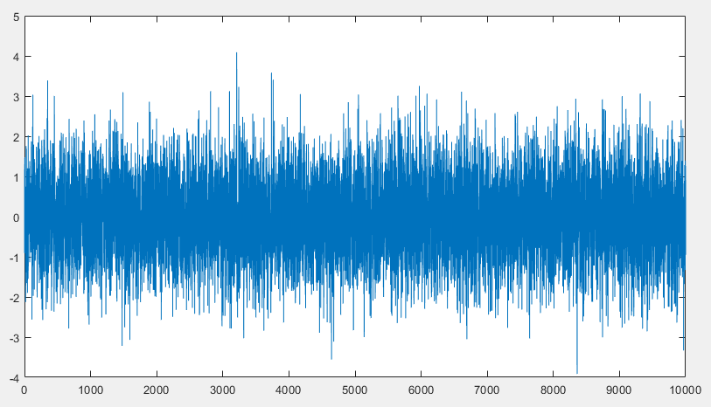
White noise
Designated by N(0,1), meaning a normally-distributed random number with a mean of zero and a standard deviation of 1.0. It can be evaluated using the “randn” function in a programming language such as Python, Matlab, etc.
White noise

Slide 34
Why
Whistles
Work
Police Whistles
Dog Whistles
Train Whistle
Ship whistles
Referee Whistles
Factory Whistles
Boatswain’s whistle
They make pitched sounds and are often used in noisy environs.
Sheep dogs
Notes:
There are many kinds of whistles, but that all have a couple of things in common. They make pitched sounds and are often used in noisy environments. Whistle patterns can contain messages, especially the whistle used to signal instructions to working dogs such as sheep dogs, and the Boatswain’s whistle that signal instructions to a sailing ship’s crew (who may by anywhere in the ship and may not all speak the same language).

Slide 35
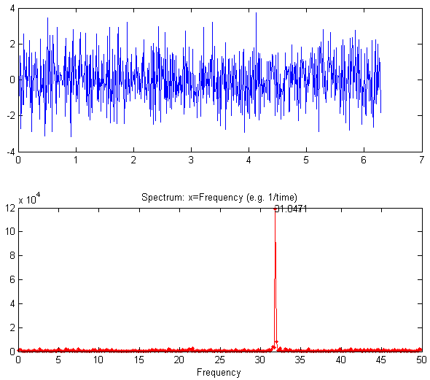
Time display
A signal consisting of sine wave plus a stronger random white noise. The sine wave is too weak to be easily detected in the time display (top right).
The Fourier frequency spectrum more clearly shown that the power of random noise is distributed over a wide frequency range, whereas the power of a sine wave is concentrated all into one frequency.
Fourier Frequency spectrum
← Sine wave
← White noise →

Slide 36
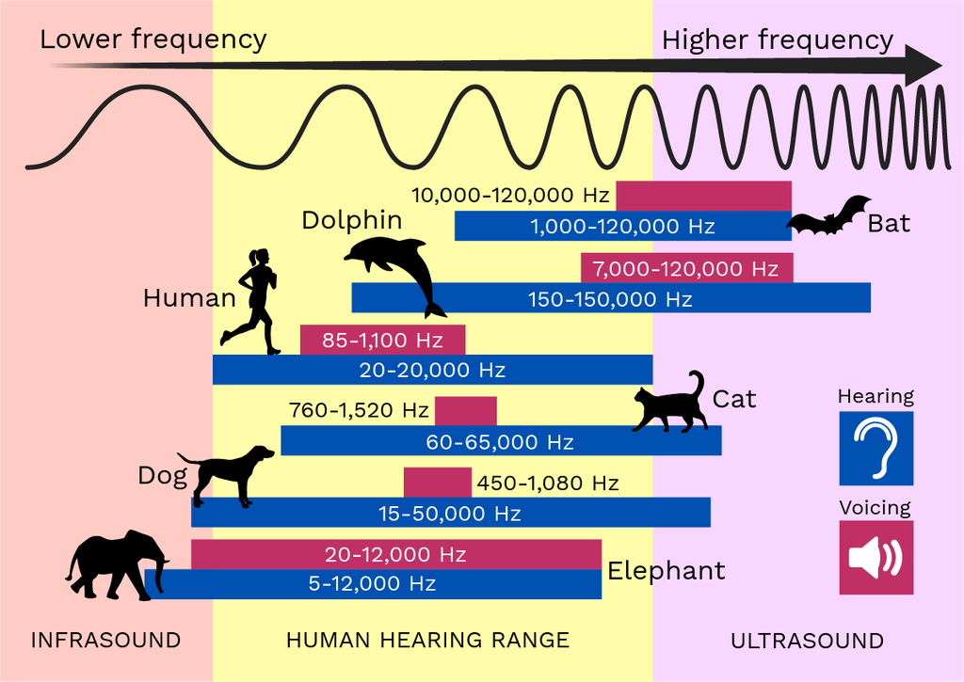
Hearing and Voicing Ranges
https://theory.labster.com/hearing-range-dbs/

Slide 37

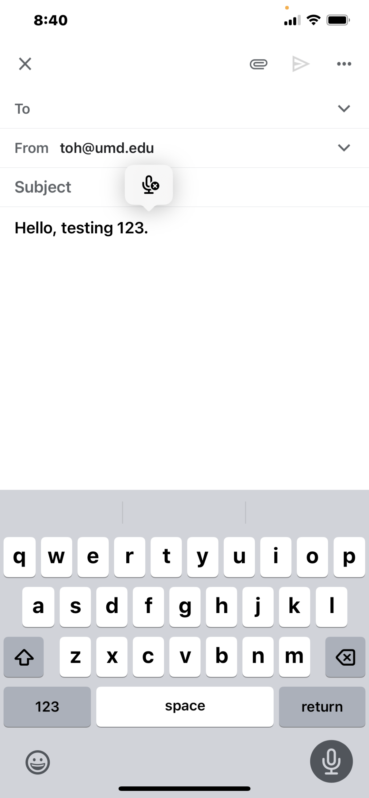
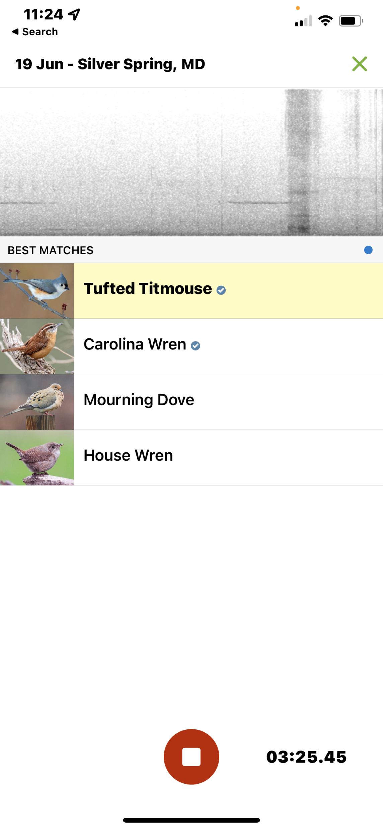

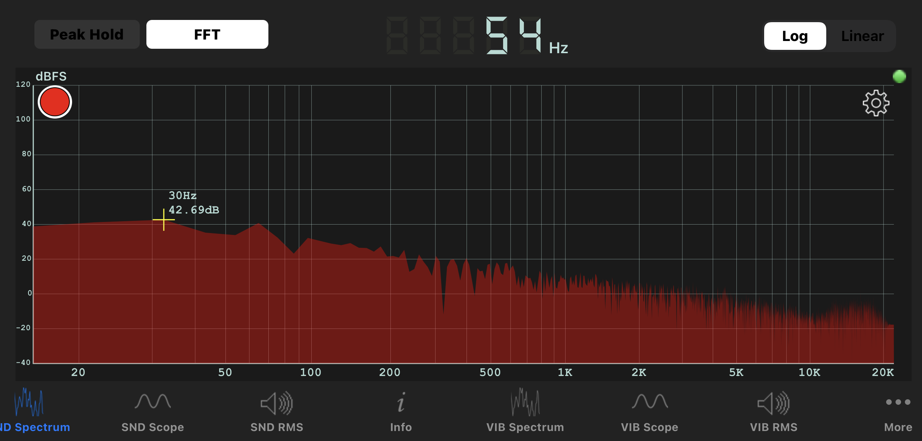
multi-track audio recording and effects editing.
Speech transcription
Merlin Bird ID
Digital Audio Workstations (DAW) (e.g. Waveform Free, etc.)
Shazam, recorded music identification app
Sonic Tools spectrum analyzer app
Notes:
Useful sound-based programs and apps, all free.

Slide 38
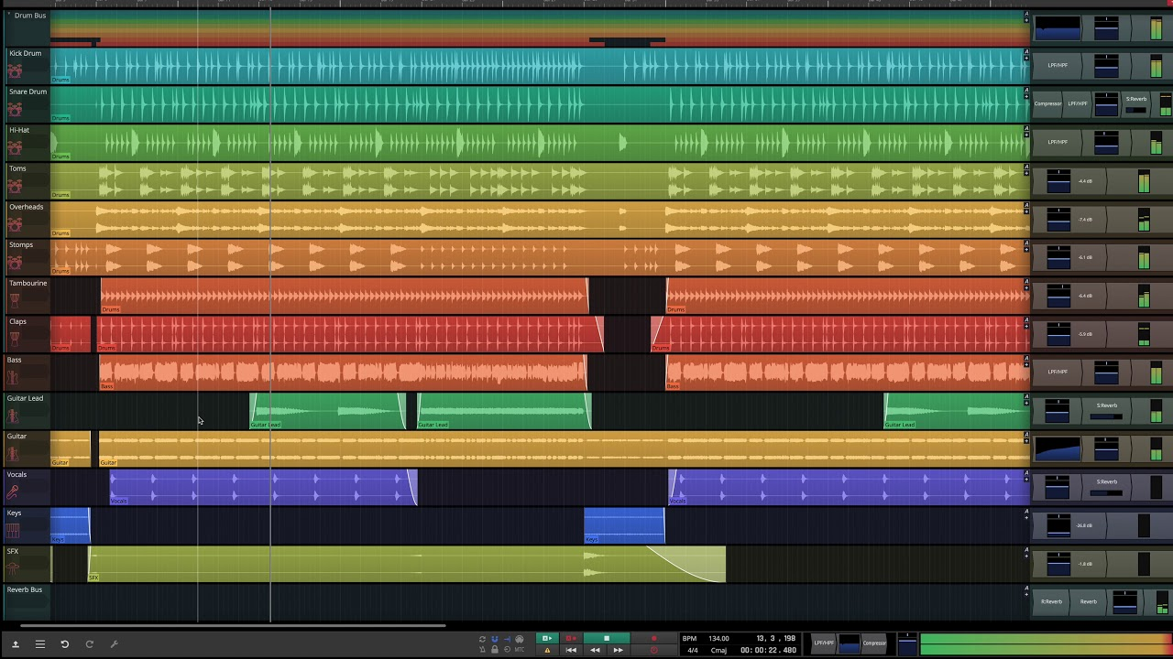
Waveform Free
Notes:
Waveform Free is a freeware digital audio workstation.

Slide 39
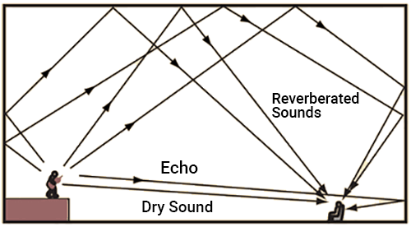
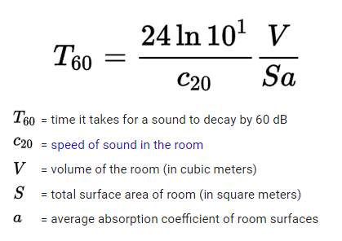
Reverberation
The Sabine Equation
Digital reverberation attempts to re-create the effect of a large performance space, by adding the original sound to multiple delayed and filtered versions.
A single instrument playing a single melodic line with no reverb (Dry sound)
Notes:
Reverberation is "arguably the oldest and most universal sound effect in music”; think of medieval monks chanting in cathedrals. Musicians often talk about the quality of the “sound” of a performance space. Mostly they are talking about the acoustics and the quality of the reverberation. That depends not only on the size and shape of a space, but on the effect of damping by curtains, panels, seats, and even the audience members themselves.

Slide 40
Reverberation
The Sabine Equation
Digital reverberation attempts to re-create the effect of a large performance space, by adding the original sound to multiple delayed and filtered versions.
The same recording with digital reverb added.
Notes:
Reverberation is "arguably the oldest and most universal sound effect in music”; think of medieval monks chanting in cathedrals. Musicians often talk about the quality of the “sound” of a performance space, arguing for example whether Carnegie Hall in New York sounds better that Symphony Hall in Boston. . Mostly they are talking about the acoustics and the quality of the reverberation. That depends not only on the size and shape of a space, but on the effect of damping by curtains, panels, seats, and even the audience members themselves.

Slide 41
Digital Audio Allows Tempo and Pitch to be Changed Independently
Original:
Faster tempo, same pitch:
Lower pitch, same tempo:
Auto-tune: real-time pitch correction:
The math involved is complex, and sometimes proprietary, but typically employs chopping up the audio into small time segments, using the Short Time Fourier Transform (STFT), followed by manipulating the data in the frequency domain, inverse Fourier transforming (IFT) back into the time domain, and finally cross-fading between segments to produce a continuous audio signal.
Notes:
Those of us old enough to remember tape recorders and vinyl records will appreciate that slowing down a song by switching to a lower speed, perhaps to learn how to play the guitar parts, will also change the pitch. But digital audio frees us from that limitation.

Slide 42
Digital Audio Allows Tempo and Pitch to be Changed Independently
Original:
Faster tempo, same pitch:
Lower pitch, same tempo:
Auto-tune: real-time pitch correction:
The math involved is complex, and sometimes proprietary, but typically employs chopping up the audio into small time segments, using the Short Time Fourier Transform (STFT), followed by manipulating the data in the frequency domain, inverse Fourier transforming (IFT) back into the time domain, and finally cross-fading between segments to produce a continuous audio signal.
Notes:
Those of us old enough to remember tape recorders and vinyl records will appreciate that slowing down a song by switching to a lower speed, perhaps to learn how to play the guitar parts, will also change the pitch. But digital audio frees us from that limitation.

Slide 43
Digital Audio Allows Tempo and Pitch to be Changed Independently
Original:
Faster tempo, same pitch:
Lower pitch, same tempo:
Auto-tune: real-time pitch correction:
The math involved is complex, and sometimes proprietary, but typically employs chopping up the audio into small time segments, using the Short Time Fourier Transform (STFT), followed by manipulating the data in the frequency domain, inverse Fourier transforming (IFT) back into the time domain, and finally cross-fading between segments to produce a continuous audio signal.
Notes:
Those of us old enough to remember tape recorders and vinyl records will appreciate that slowing down a song by switching to a lower speed, perhaps to learn how to play the guitar parts, will also change the pitch. But digital audio frees us from that limitation.

Slide 44
Digital Audio Allows Tempo and Pitch to be Changed Independently
Original:
Faster tempo, same pitch:
Lower pitch, same tempo:
Auto-tune: real-time pitch correction:
The math involved is complex, and sometimes proprietary, but typically employs chopping up the audio into small time segments, using the Short Time Fourier Transform (STFT), followed by manipulating the data in the frequency domain, inverse Fourier transforming (IFT) back into the time domain, and finally cross-fading between segments to produce a continuous audio signal.
Notes:
Those of us old enough to remember tape recorders and vinyl records will appreciate that slowing down a song by switching to a lower speed, perhaps to learn how to play the guitar parts, will also change the pitch. But digital audio frees us from that limitation.

Slide 45
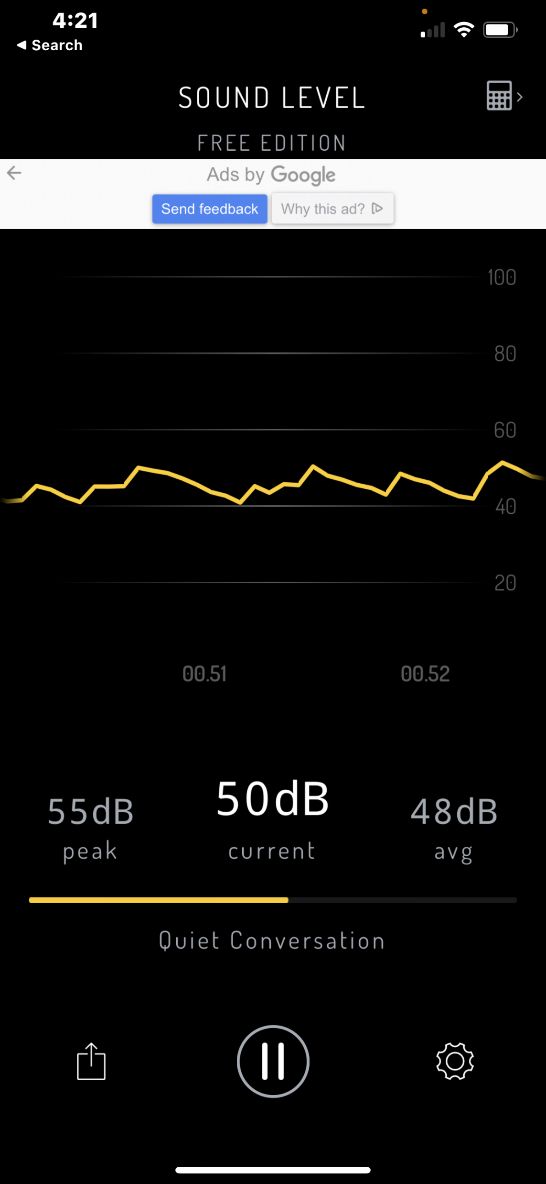
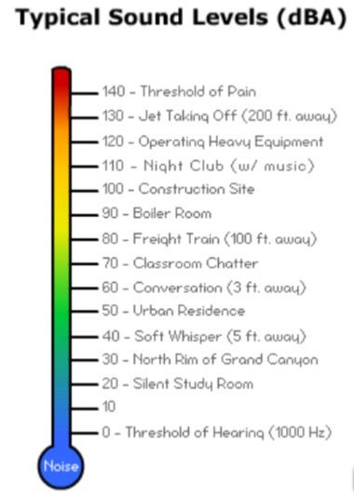
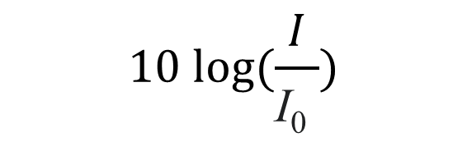
Measuring Sound Level
Sound level is measured in decibels (dB), defined as:
$$10 log⁡(\frac{I}{\text{I}\text{0} })$$
where I is the sound intensity and
I₀ is the lowest sound intensity hearable by an undamaged human ear under room conditions.
So, a sound waveform that is 10x greater in magnitude produces a sound that is 10 decibels (dB) louder.
Sound Level app
Notes:
Sound levels can be measured by the “Sound Level” or “Sonic Tools” apps.

Slide 46
Loud Sounds | Sound Level (db) | After routine or repeated exposure
Motorcycle engine running | 95 | Damage to hearing possible after about 50 minutes of exposure
Gas-powered lawnmowers and leaf blowers | 80-85 | Damage to hearing possible after 2 hours of exposure
sporting events (such as hockey playoffs and football games) | 100 | Hearing loss possible after 15 minutes
entertainment venues (nightclubs, bars, and rock concerts) | 105–110 | Hearing loss possible in less than 5 minutes
Shouting or barking in the ear | 110 | Hearing loss possible in less than 2 minutes
Standing beside or near sirens | 120 | Pain and ear injury
Firecrackers | 140–150 | Pain and ear injury
Long exposure to loud sounds can damage ears
Workers often wear headphones while working with loud machinery to reduce ear damage. Ordinary noise-cancelling headphones can also do the same.

Slide 47
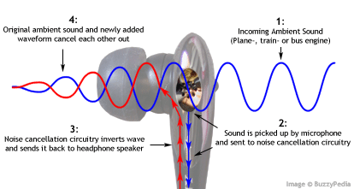
How do noise-cancelling earbuds and headphones work?
A tiny microphone on the exterior picks up ambient noise.
That signal is inverted (multiplied by -1) and added to the music signal from your phone or iPod.
The earbuds converts that combined signal into sound (Music-Noise).
Your ear hears both that sound plus the ambient noise from the outside, and the noise is canceled out.
(Music-Noise) + Noise = Music

Slide 48
MIDI (Musical Instrument Digital Interface)
MIDI is a technical standard that describes a communication protocol, digital interface, and electrical connectors that connect a wide variety of electronic musical instruments, computers, and related audio devices for playing, editing, and recording music.
A single MIDI cable can carry up to sixteen channels of MIDI data, each of which can be routed to a separate device. Each interaction with a key, button, knob or slider is converted into a MIDI event, which specifies musical instructions, such as a note's pitch, timing and loudness.
Music from a printed score can be entered (or scanned) into a MIDI program, which will play it exactly as scored. But this leaves out the human factor, leaving a soulless, mechanical sound. But MIDI-connected keyboards can record live performances exactly, with all the interpretive nuances.

Slide 49

Thank you!
Tom O’Haver

Slide 50
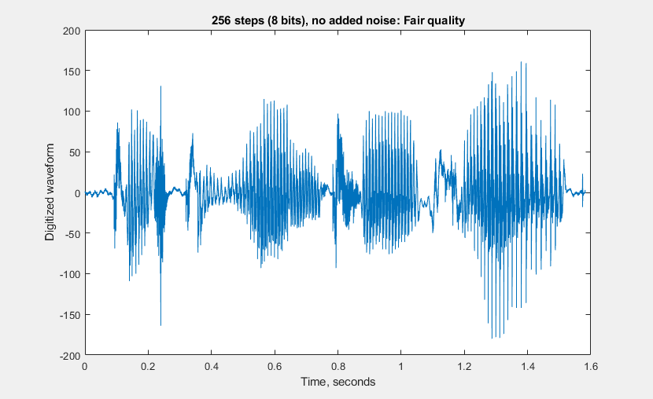
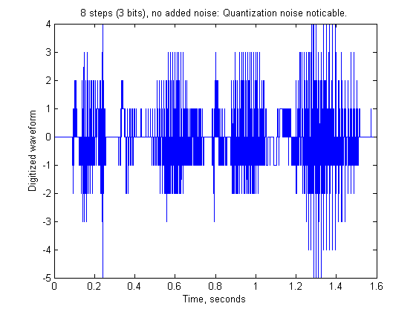


Effect of data range
“Testing, one, two, three”
8 bit data. 256 levels
$$2^{8}=256$$
3 bit data. 8 levels
$$2^{3}=8$$

Slide 51
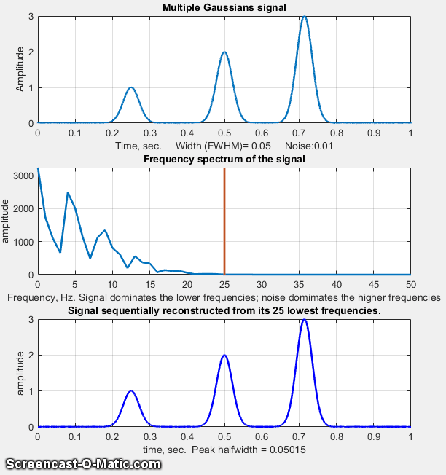
Signals of any shape can be constructed from a sufficient number of sine and cosine components.
These Gaussian peaks are smooth and require only a relatively small number of frequency components.

Slide 52
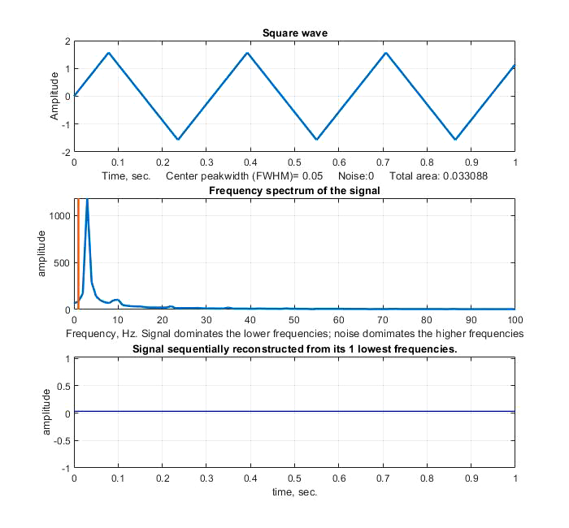
A triangle wave requires more frequency components for a good reconstruction, because of its sharp points.

Slide 53
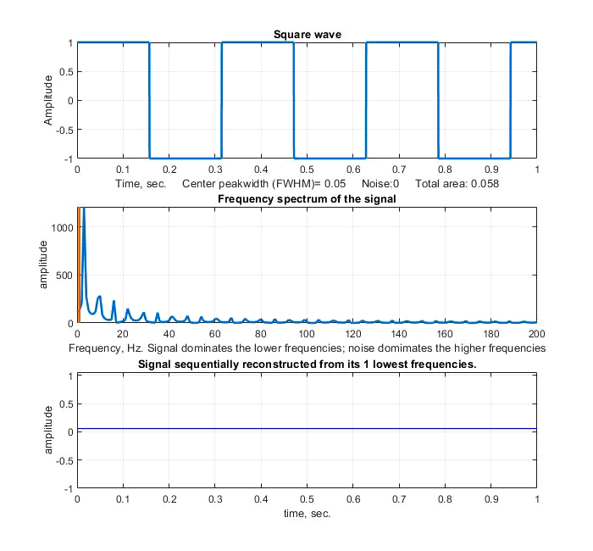
This square wave’s abrupt transitions between -1 and +1 causes problems.
This is called the “Gibbs Phenomenon”.

Slide 54
References
Best freeware synthesizers:
https://musictech.com/guides/buyers-guide/best-freeware-synths/
Understanding the Karplus-Strong with Python (Synthetic Guitar Sounds Included)
https://flothesof.github.io/Karplus-Strong-algorithm-Python.html
T. C. O'Haver, "Audio Processing with a Microprocessor," Byte, the Small Systems Journal, June 1978, p. 166.
Best Guitar Amp Simulators
https://www.pianodreamers.com/best-amp-simulators/
Thanks to OpenAI. (2023). ChatGPT (August 3 Version) [Large language model], for suggestions. https://chat.openai.com

